Slide 1
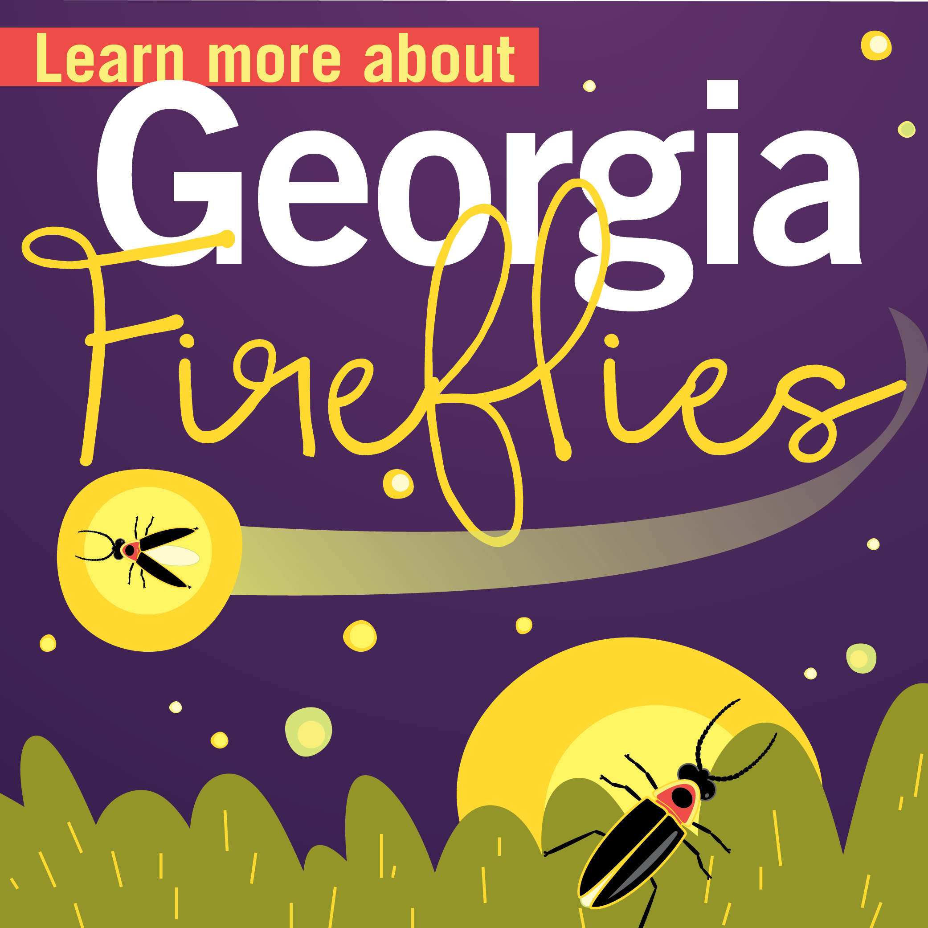
Introduction to Fireflies PowerPoint
Part 1 of 2 Firefly Educator Series
Lights OFF, Fireflies ON project
Created by Becky Griffin
beckygri@uga.edu

Slide 2
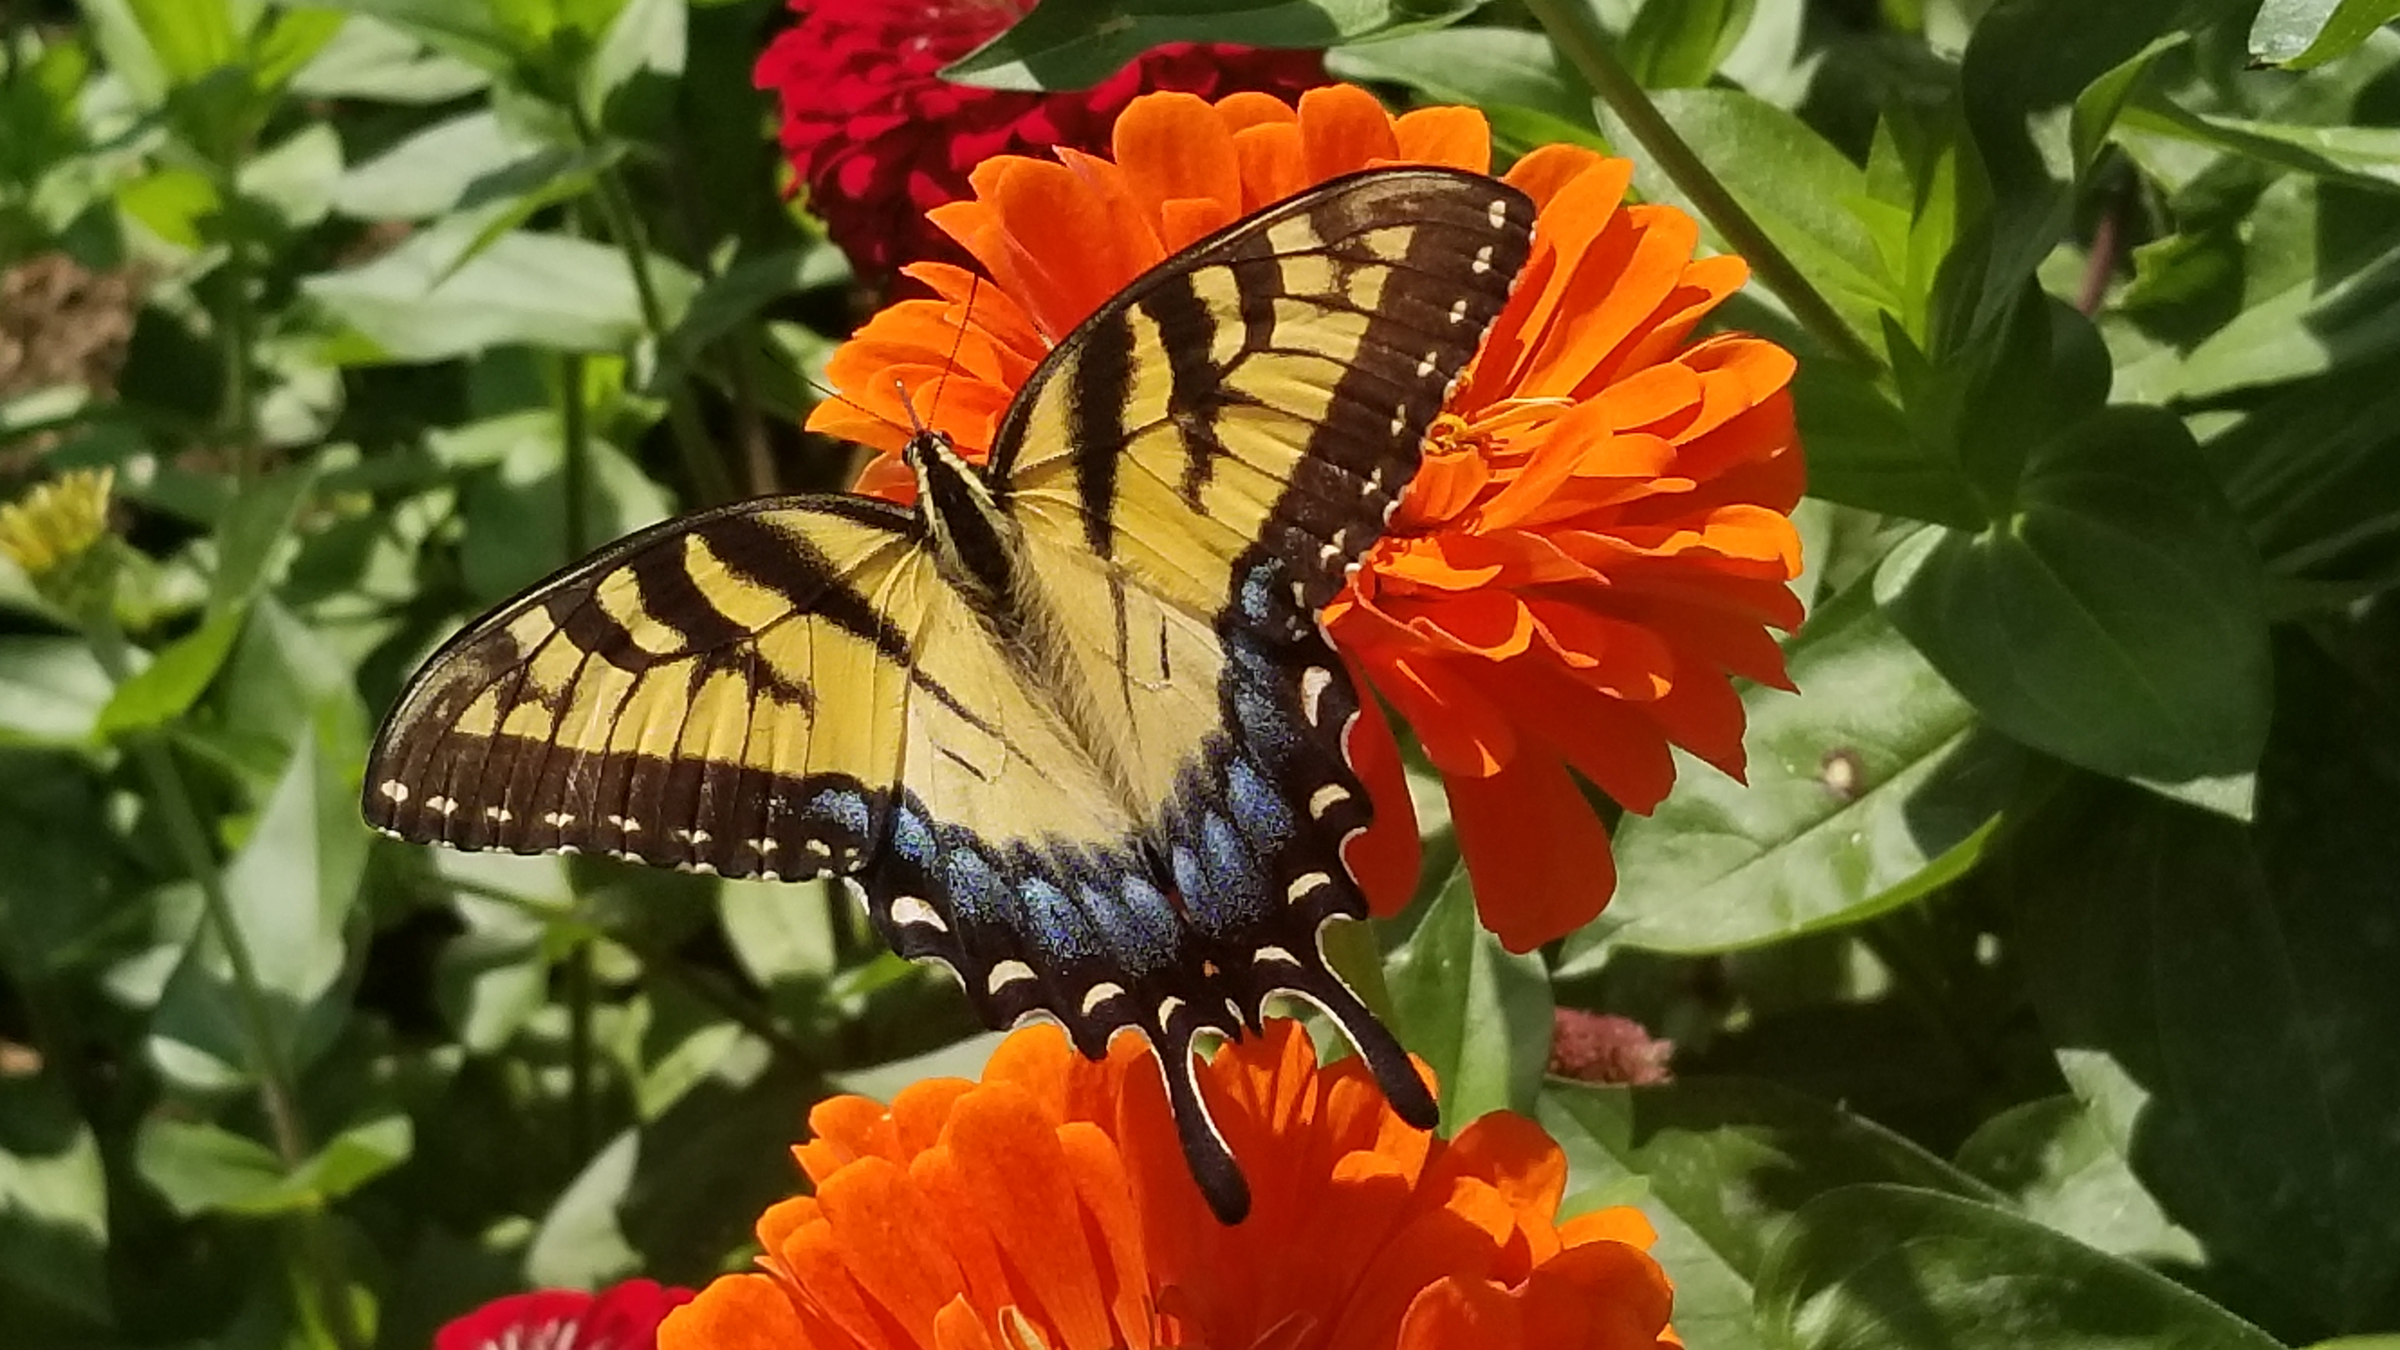
Notes:
For the next slides, show the photos of the insects. Have the students get up from their seats. If the insect image is positive for them, have them move to one side of the room. If the insect image is negative or scary to them, have them move to another side of the room. For those who have no thoughts or feelings about the insect, have them stay in the middle. After the students divide themselves, ask for a representative of each group and ask them why they feel that way about the insect. Have they had a negative experience with the insect? Do they know the role of the insect in the ecosystem, etc. This is an Eastern Tiger Swallowtail, our Georgia state butterfly. They are pollinators and cannot sting or bite.

Slide 3
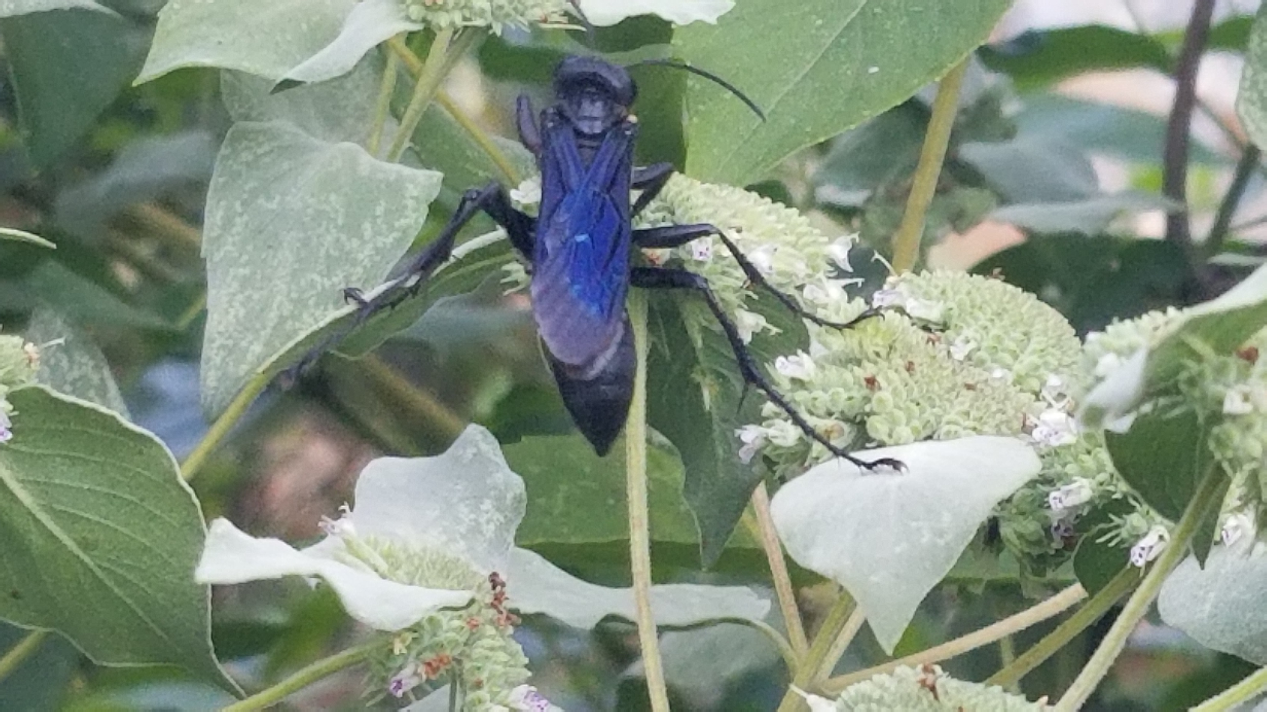
Notes:
This is a great black wasp (Sphex pensylvanicus). Although this adult insect may feed on some pollen, it really is a hunter. The female will hunt for soft-bodied insects and paralyze them. She carries them back to her underground nest for her young to feed on. This insect is also an incidental pollinator, spreading pollen as it moves around the plant. This insect has an important role in the garden ecosystem by keeping down the number of insect pests. These wasps are not interested in you as you offer nothing for them. They generally don’t sting unless they are threatened or their nest is threatened. Only females can sting.

Slide 4
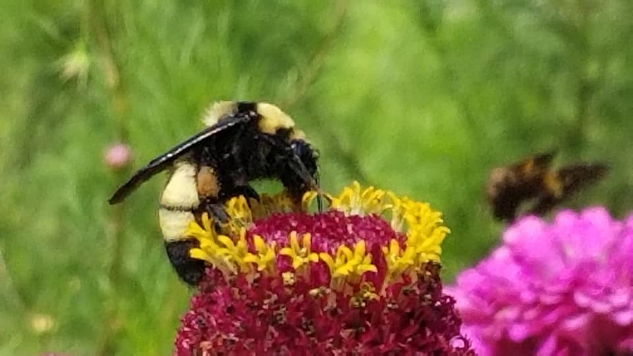
Notes:
This is an American Bumble Bee (Bombas pensylvanicus) is an amazing pollinator. It consumes nectar for energy and pollen for protein. Only the females can sting and as with the Great Black Wasp they generally only sting when threatened. This insect is very valuable in the pollination of flowers and food crops.

Slide 5
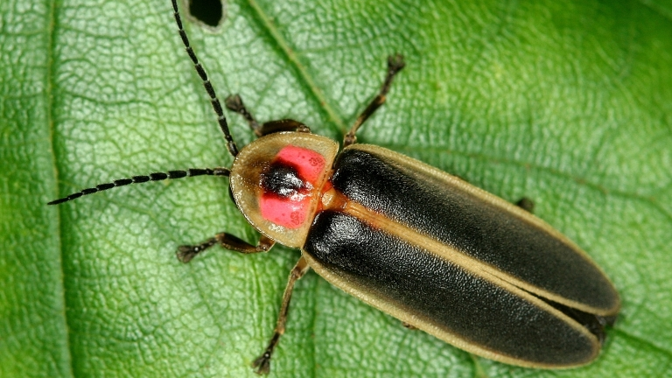
UGA2158030
Photo by David Cappaert, Bugwood images
Notes:
This is a firefly Photinus spp. found across the Southeast US

Slide 6
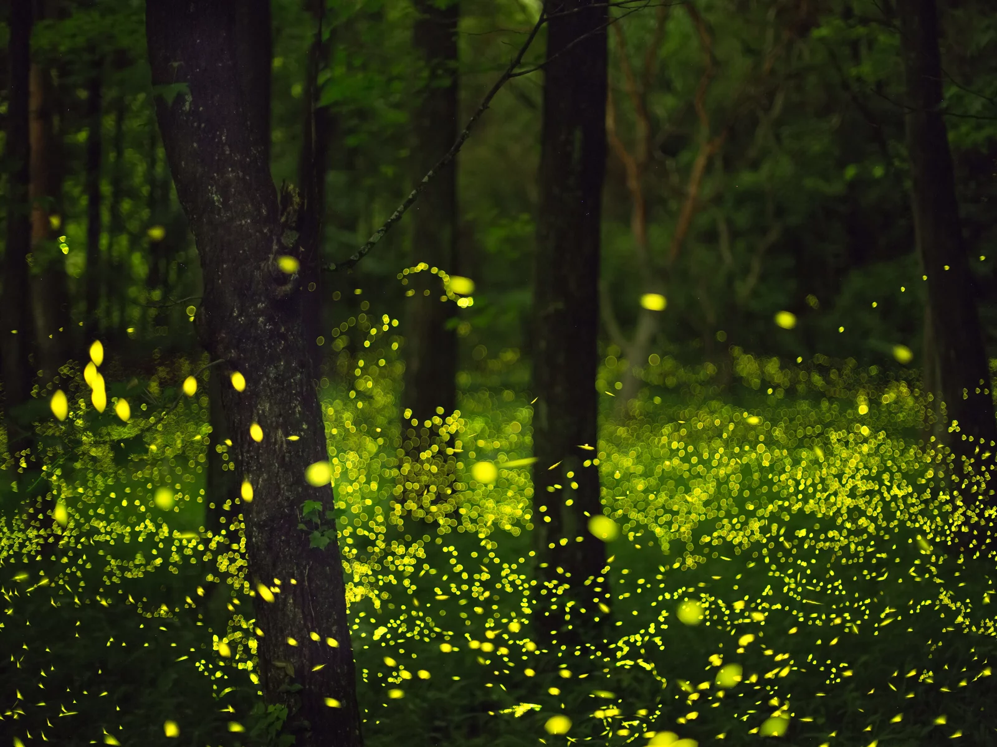
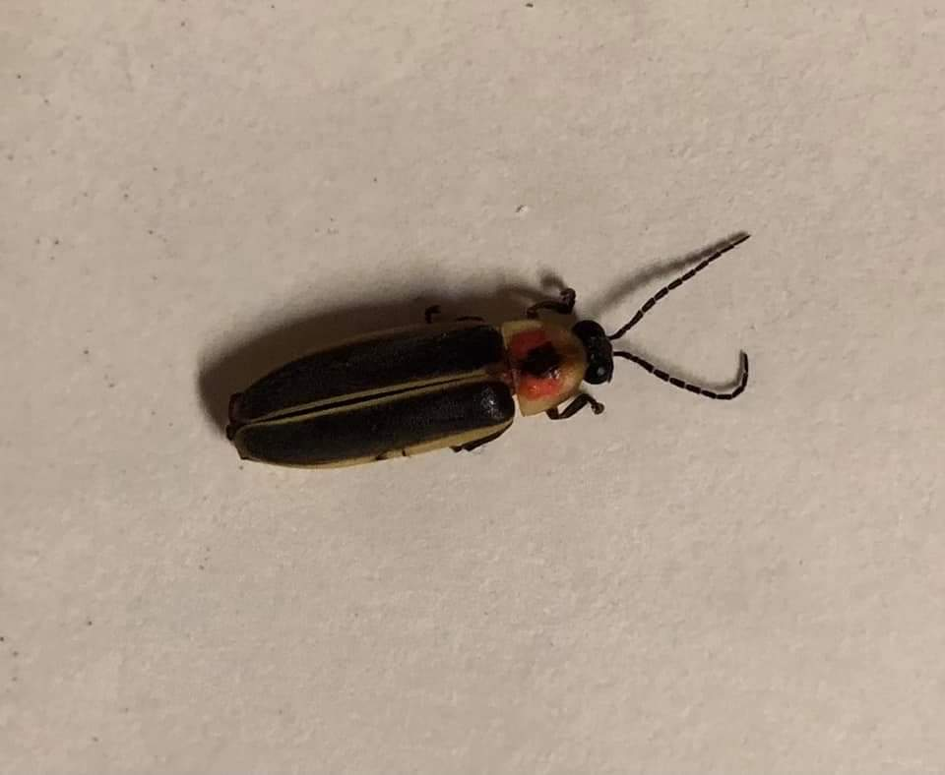
Firefly
Or
Lightning Bug?
Notes:
Ask your class if they know them as “fireflies” or “lightning bugs”. There is an official poll sheet location on the firefliesON.com/educators website you can use for this activity.

Slide 7
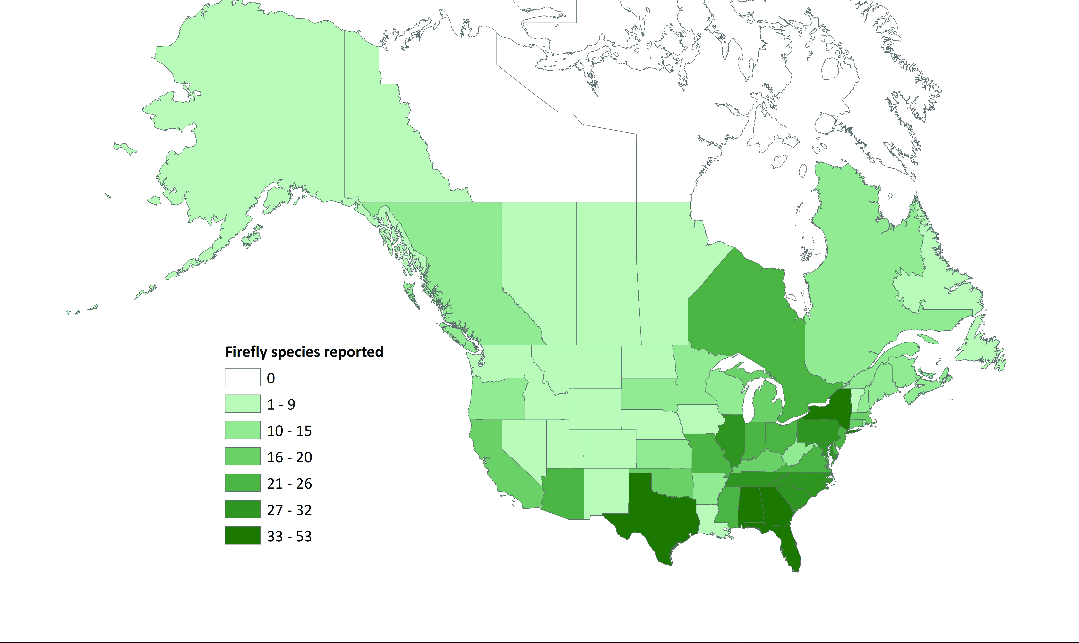
Fireflies in the US
Data from Xerces Society 2019
Notes:
2,000+ species worldwide; 135+ species in US; on every continent but Antarctica. Notice how many are found in Georgia – approximately 50 species.

Slide 8
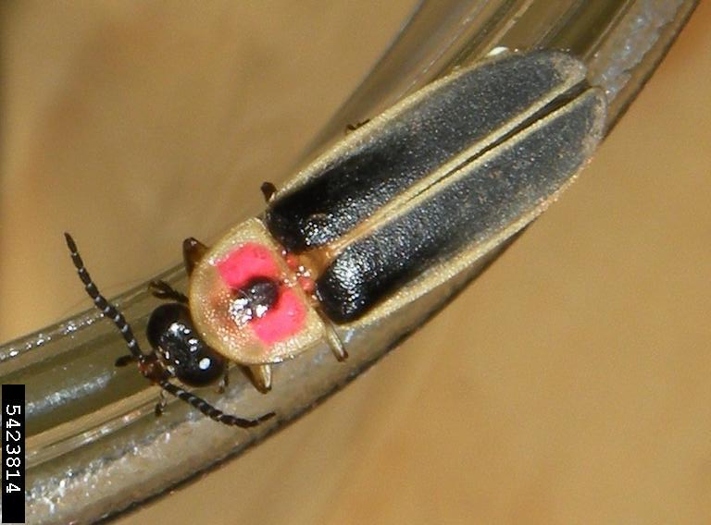
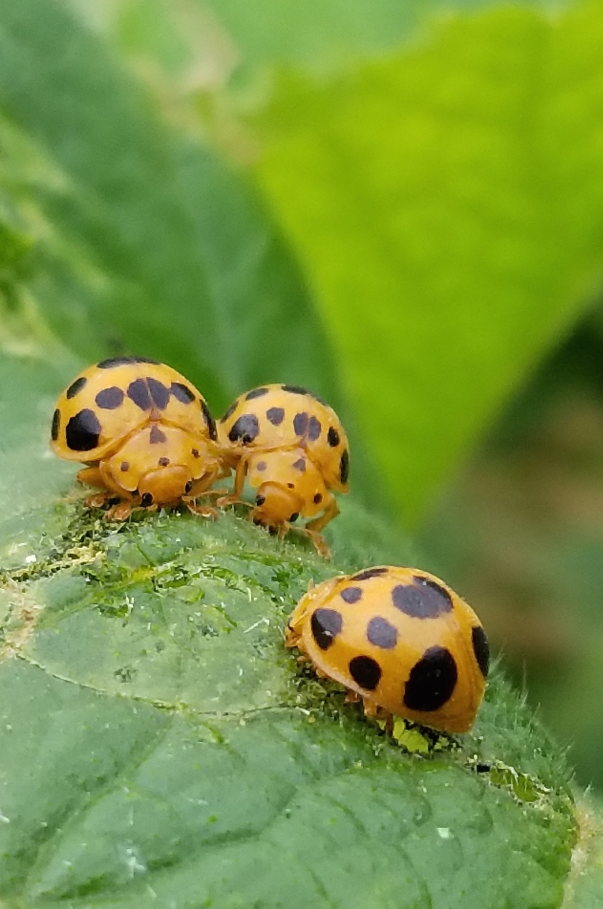
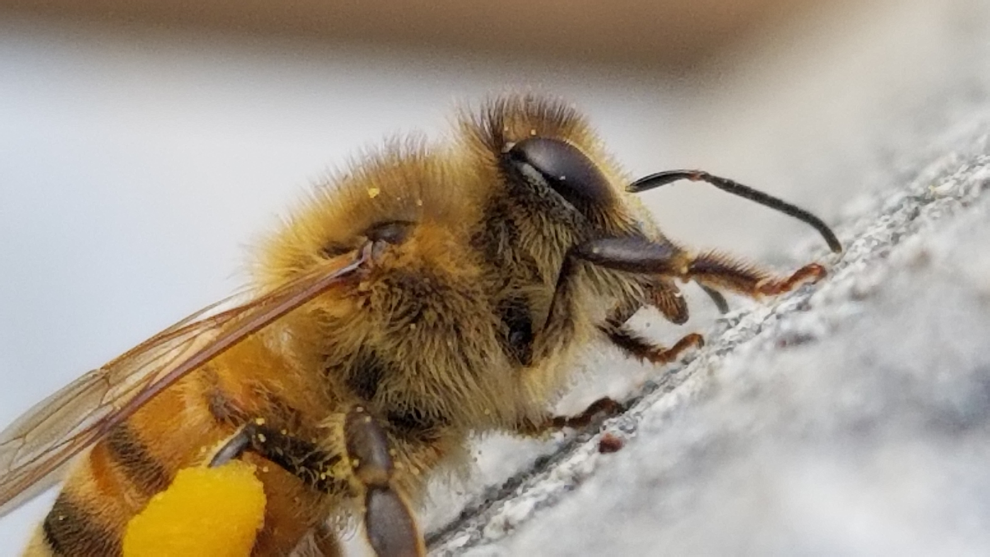
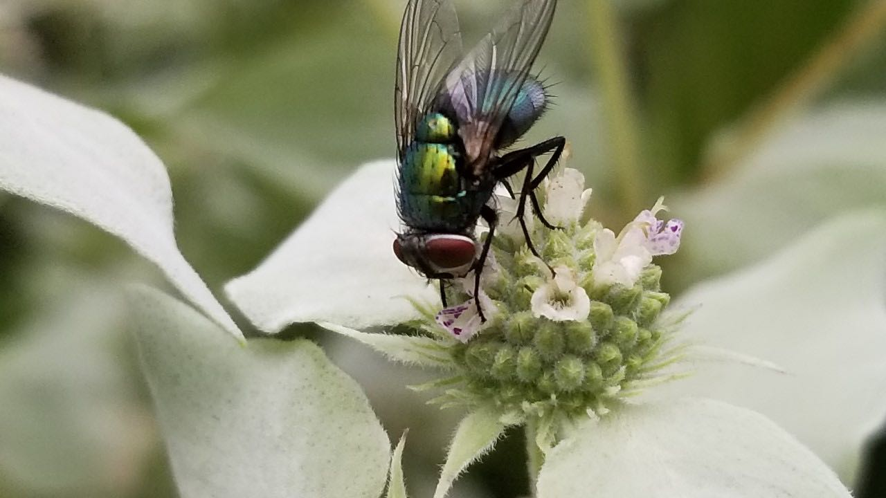
Kingdom Animalia
Phylum Arthropoda
Class Insecta
Order
Photo by Jessica Louque, Smithers Viscient, Bugwood.org
Hymenoptera
Bees, Wasps, and Ants
Diptera
Flies
Coleoptera
Beetles
These three photos by Becky Griffin
Notes:
In science we break down organisms into taxonomic categories. Insecta, or insects, have six jointed legs, three body parts, and an exoskeleton. We can further break down insects into orders. Hymenoptera is the order that contains bees and wasps. Diptera (meaning two wings) contain flies. Coleoptera, the largest of the orders, contain beetles. Which order would you place fireflies? They are beetles and in the order Coleoptera.

Slide 9
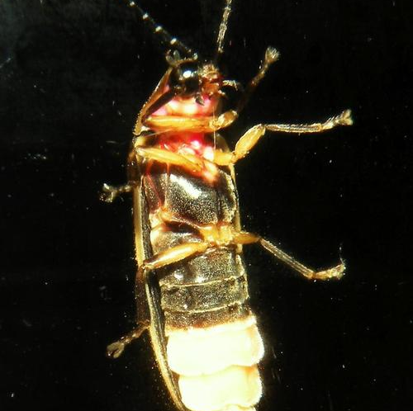
Big Dipper Firefly or
The Common Eastern Firefly
Photinus Pyralis
Kingdom Animalia
Phylum Arthropoda
Class Insecta
Order Coleoptera (beetles)
Family Lampyridae
Genus Photinus
Species Pyralis
Photo by Jessica Louque, Smithers Viscient, Bugwood. org
Notes:
The most common species of fireflies in Georgia is the Big Dipper Firefly, scientifically known as Photinus pyralis. In the taxonomic chart notice the family name contains ”lamp.”

Slide 10
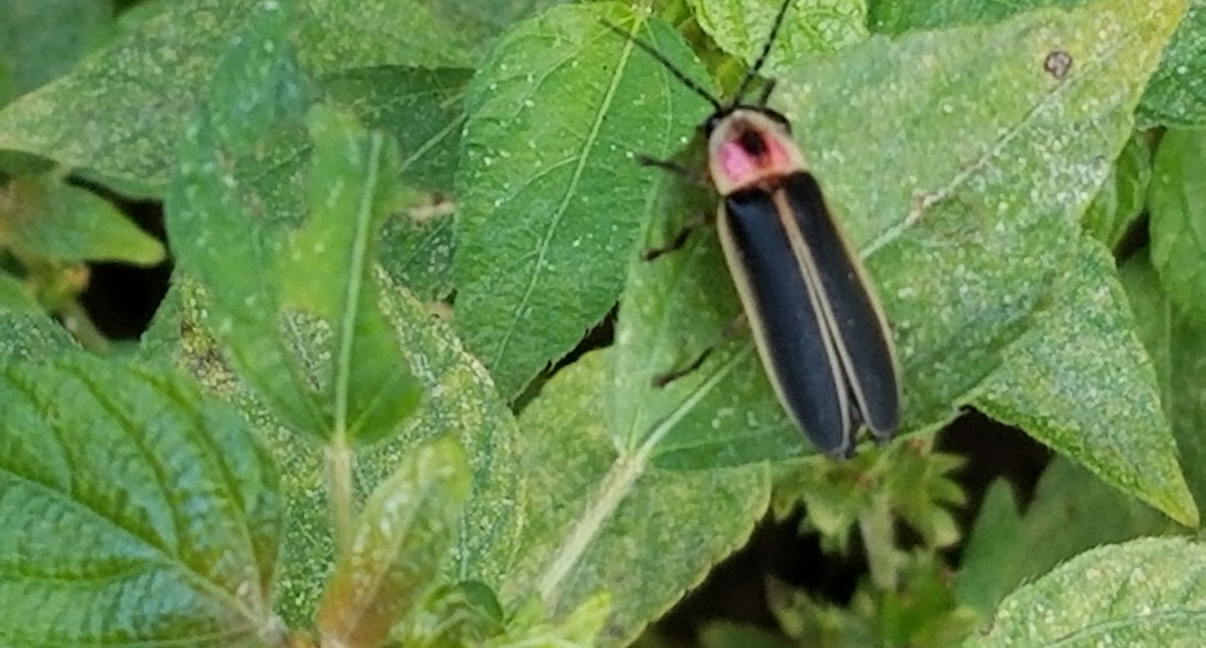
Notes:
In discussing the science of these insects, we don’t want to overlook the awe or wonder of fireflies. 2,000-year-old Chinese writings – night traveler, belly of fire; German – light beetle; Navaho Tradition relates fireflies to First Women’s desire to bring fire and light to her people; not much from Cherokee writing “insects with firetail.” Japan – departed souls of warriors

Slide 11
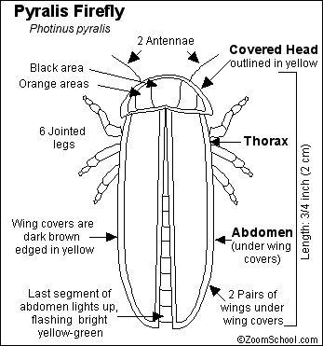
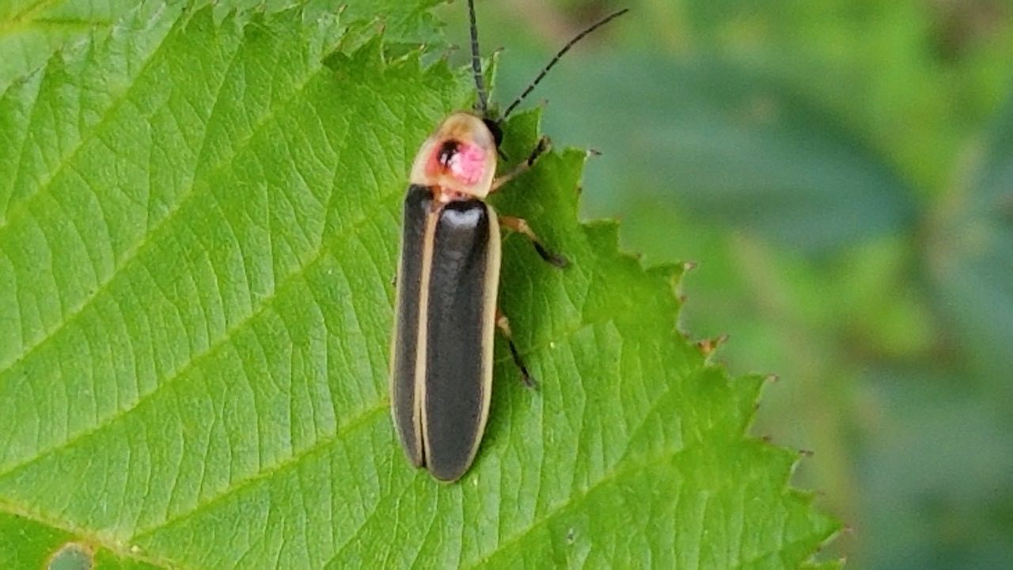
Big Dipper Firefly
Photinus Pyralis
Order: Coleoptera
Family: Lampyridae
Photo by Don Hunter
Notes:
The three insect body parts are shown here – head for the sensory organs like eyes and mouth; thorax where the legs and wings are attached (the locomotion part of the body!); and the abdomen where the lamp is

Slide 12
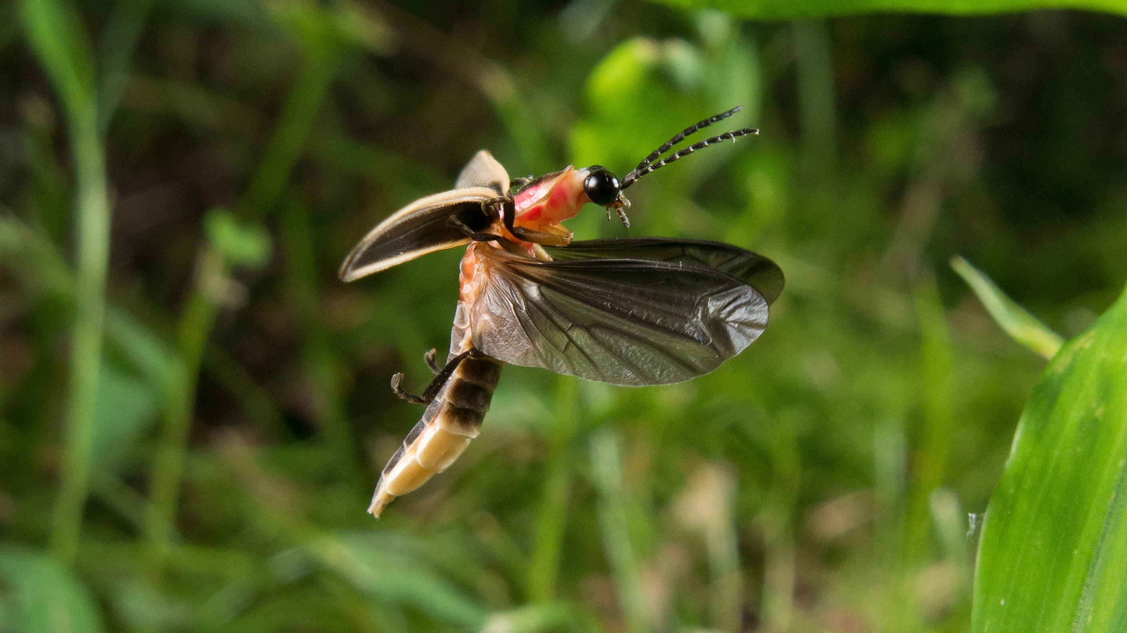
Photo by Don Hunter
Photo: Terry Priest / Flickr Creative Commons 2.0.
The common eastern firefly, or Big Dipper, Photinus pyralis. Beetles, including fireflies, have hard shells called elytra that protect their wings, which can be seen pulled back while in flight.
Their pronotum headshield protects their head. The headshield of the Big Dipper is pink.

Slide 13
Notes:
Video

Slide 14
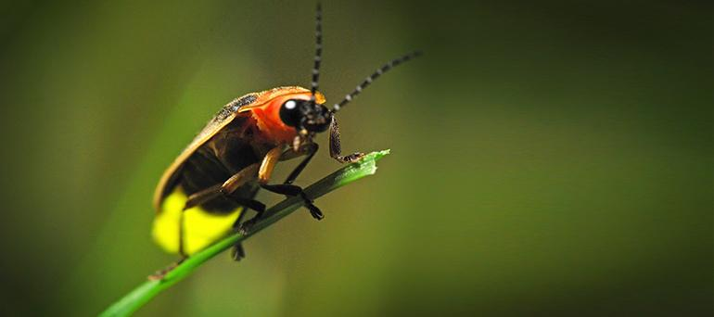
Bioluminescence:
Calcium
Luciferin
Luciferase (enzyme)
ATP (Adenosine triphosphate)
Photo from firefly.org
Notes:
These insects light up to be able to find a mate. The chemicals listed combine to create light. It is the most efficient light in the world as it does not produce heat as part of the chemical reaction. These checmials also produce an adverse reaction in predators so the lamps also serve to protect the insects from predators.

Slide 15
Notes:
Video. These synchronous fireflies may possibly also be found in Georgia

Slide 16
Firefly Biology
Big Dipper Firefly
Photinus pyralis
Notes:
Adults live 3- 30 days; lay 500 eggs on moist soil; some species are carnivorous, some don’t eat at all. Our adult Big Digger consumes nectar and pollen.

Slide 17
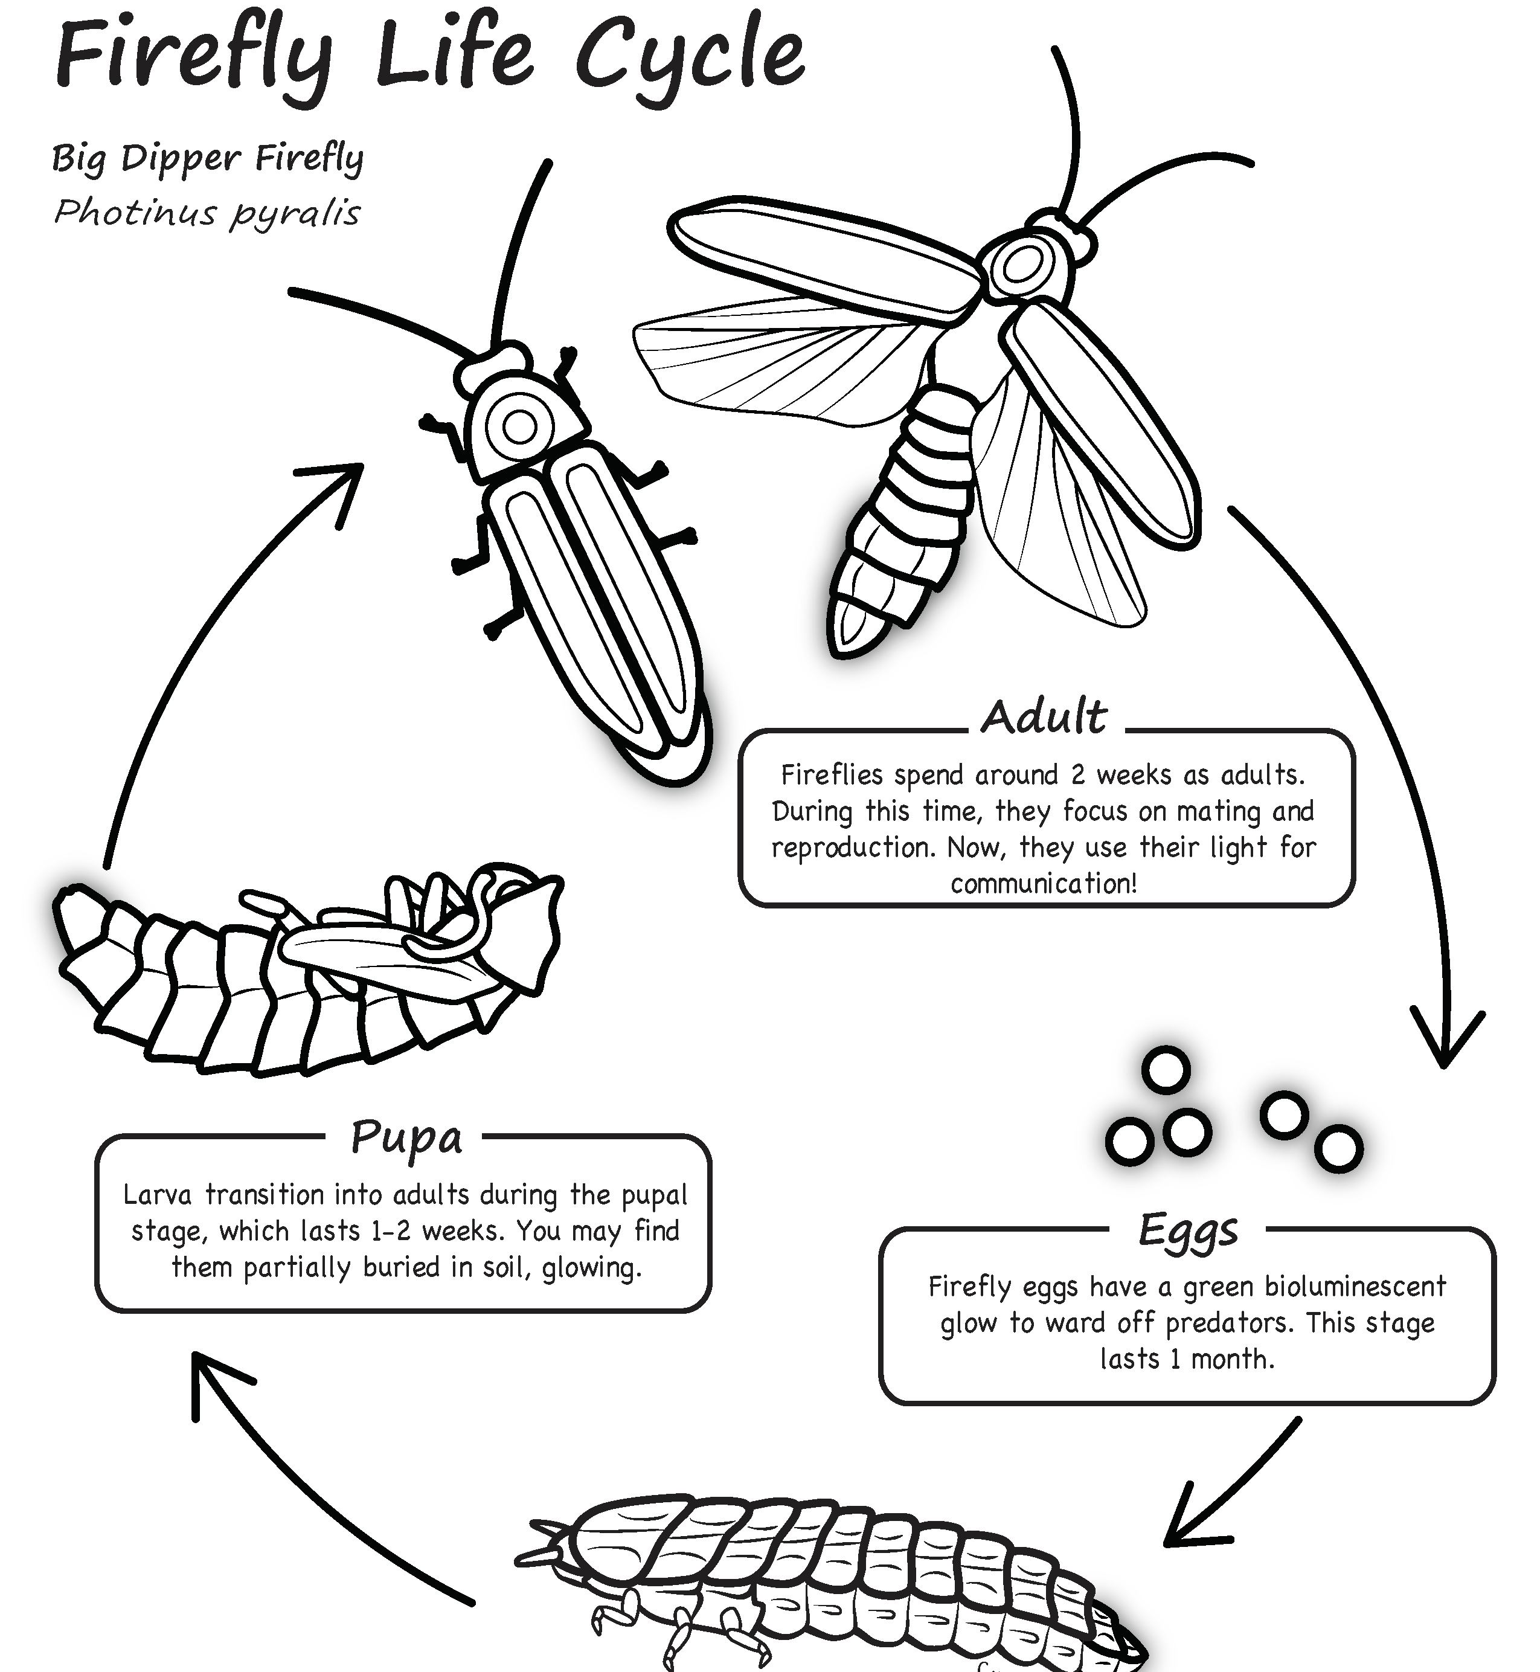
Image from ecoreach.ecology.uga.edu
Notes:
The lifecycle of fireflies. Emphasize that the larval stage is the longest 1-2 years. You can also print this out as a color sheet.

Slide 18
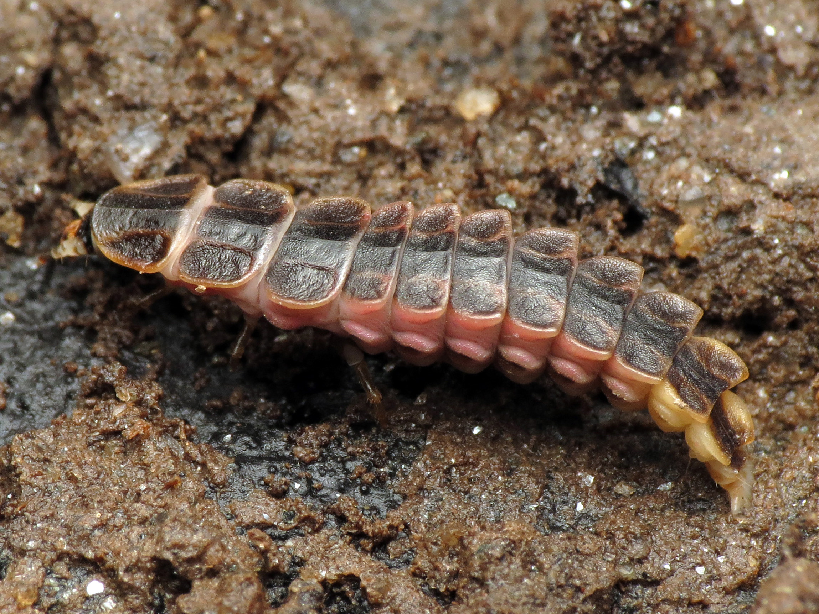
Firefly Larva
Photo by Katja Schulz, Xerces Society
Notes:
The larval form of the firefly is the longest of the life stages. These are predators of soft-bodied invertebrates. They use mandibles to inject prey full of neurotoxins. They pupate underground in mulch and/or rotting longs. Mild winters and wet springs lead to early emergence and larger numbers; all larvae are bioluminescent.

Slide 19
Big Dipper (Photinus pyralis)
J (up) |  |  |  | J(up)
Little Gray Firefly (Photinus marginellus)
X |  | X |  | X |  | X
Blue Ghost (Phausis reticulate)
X | X | X | X | X | X | X | X
Synchronous Fireflies (Photinus carolinas)
 | X | X | X |  | X | X | X
A symphony of light!
Notes:
Our big dipper firefly is also known as the J-Dipper as it makes a ”J” shape as it flies. This activity demonstrates the flash pattern of some of our common fireflies. Divide the class into four groups. Each group is assigned one of the firefly species. Have the class use their foot to start a beat. Have them tap out 8 beats and then show their flash by clapping. For example for the big dipper, the students will clap on beat one and beat four. For the little gray firefly the students class on beat 1, 3, 5, and 7. You are demonstrating the flashes by sound.

Slide 20
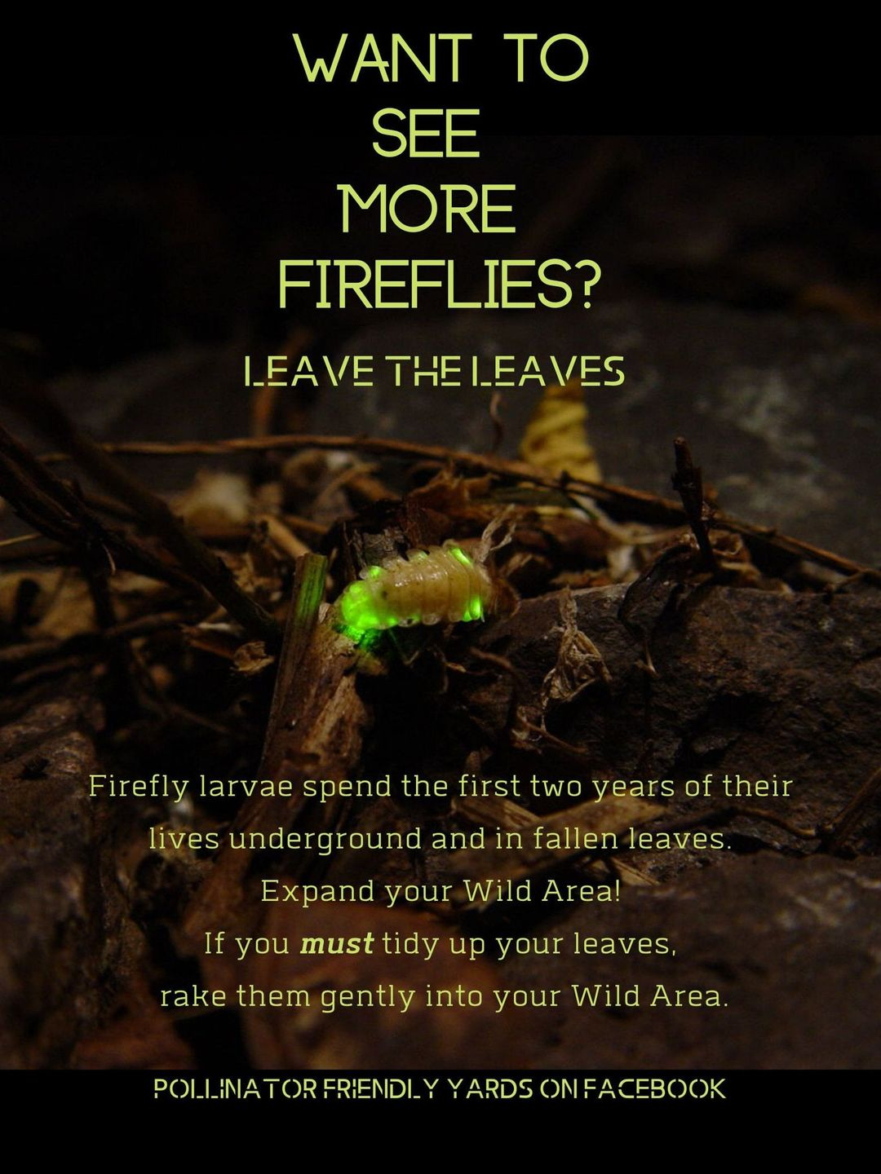
How to help fireflies:
Create habitat
Limit Pesticides
Preserve wet areas
Turn off outdoor lights
Notes:
We will go into these principles in part 2.

Slide 21
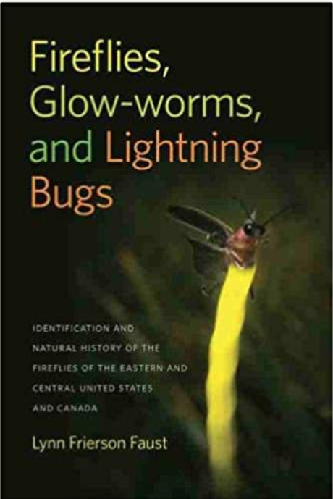
Notes:
This reference book is a great classroom reference.

Slide 22
Introduction to Fireflies PowerPoint
Part 1 of 2 Firefly Educator Series
Lights OFF, Fireflies ON project
Created by Becky Griffin
beckygri@uga.edu

