Slide 1
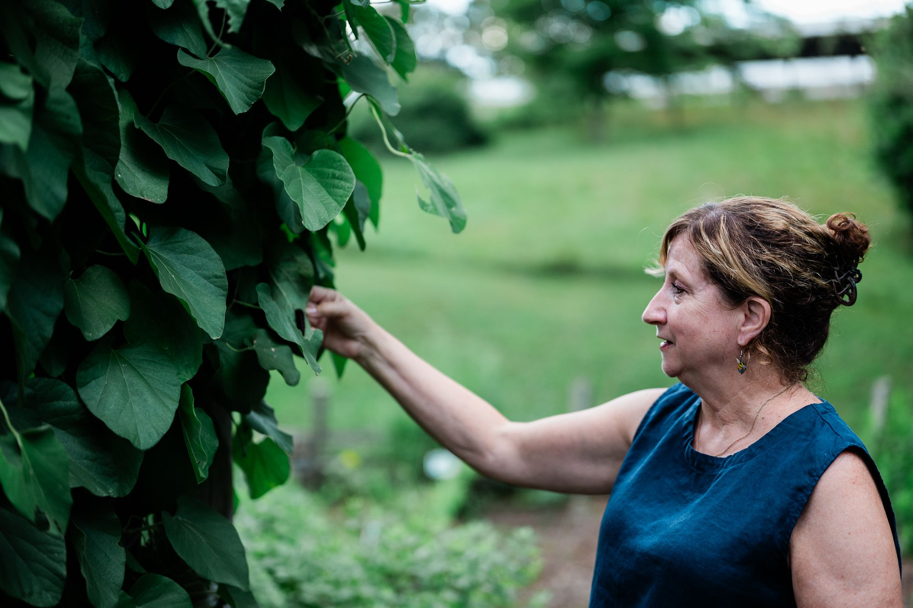
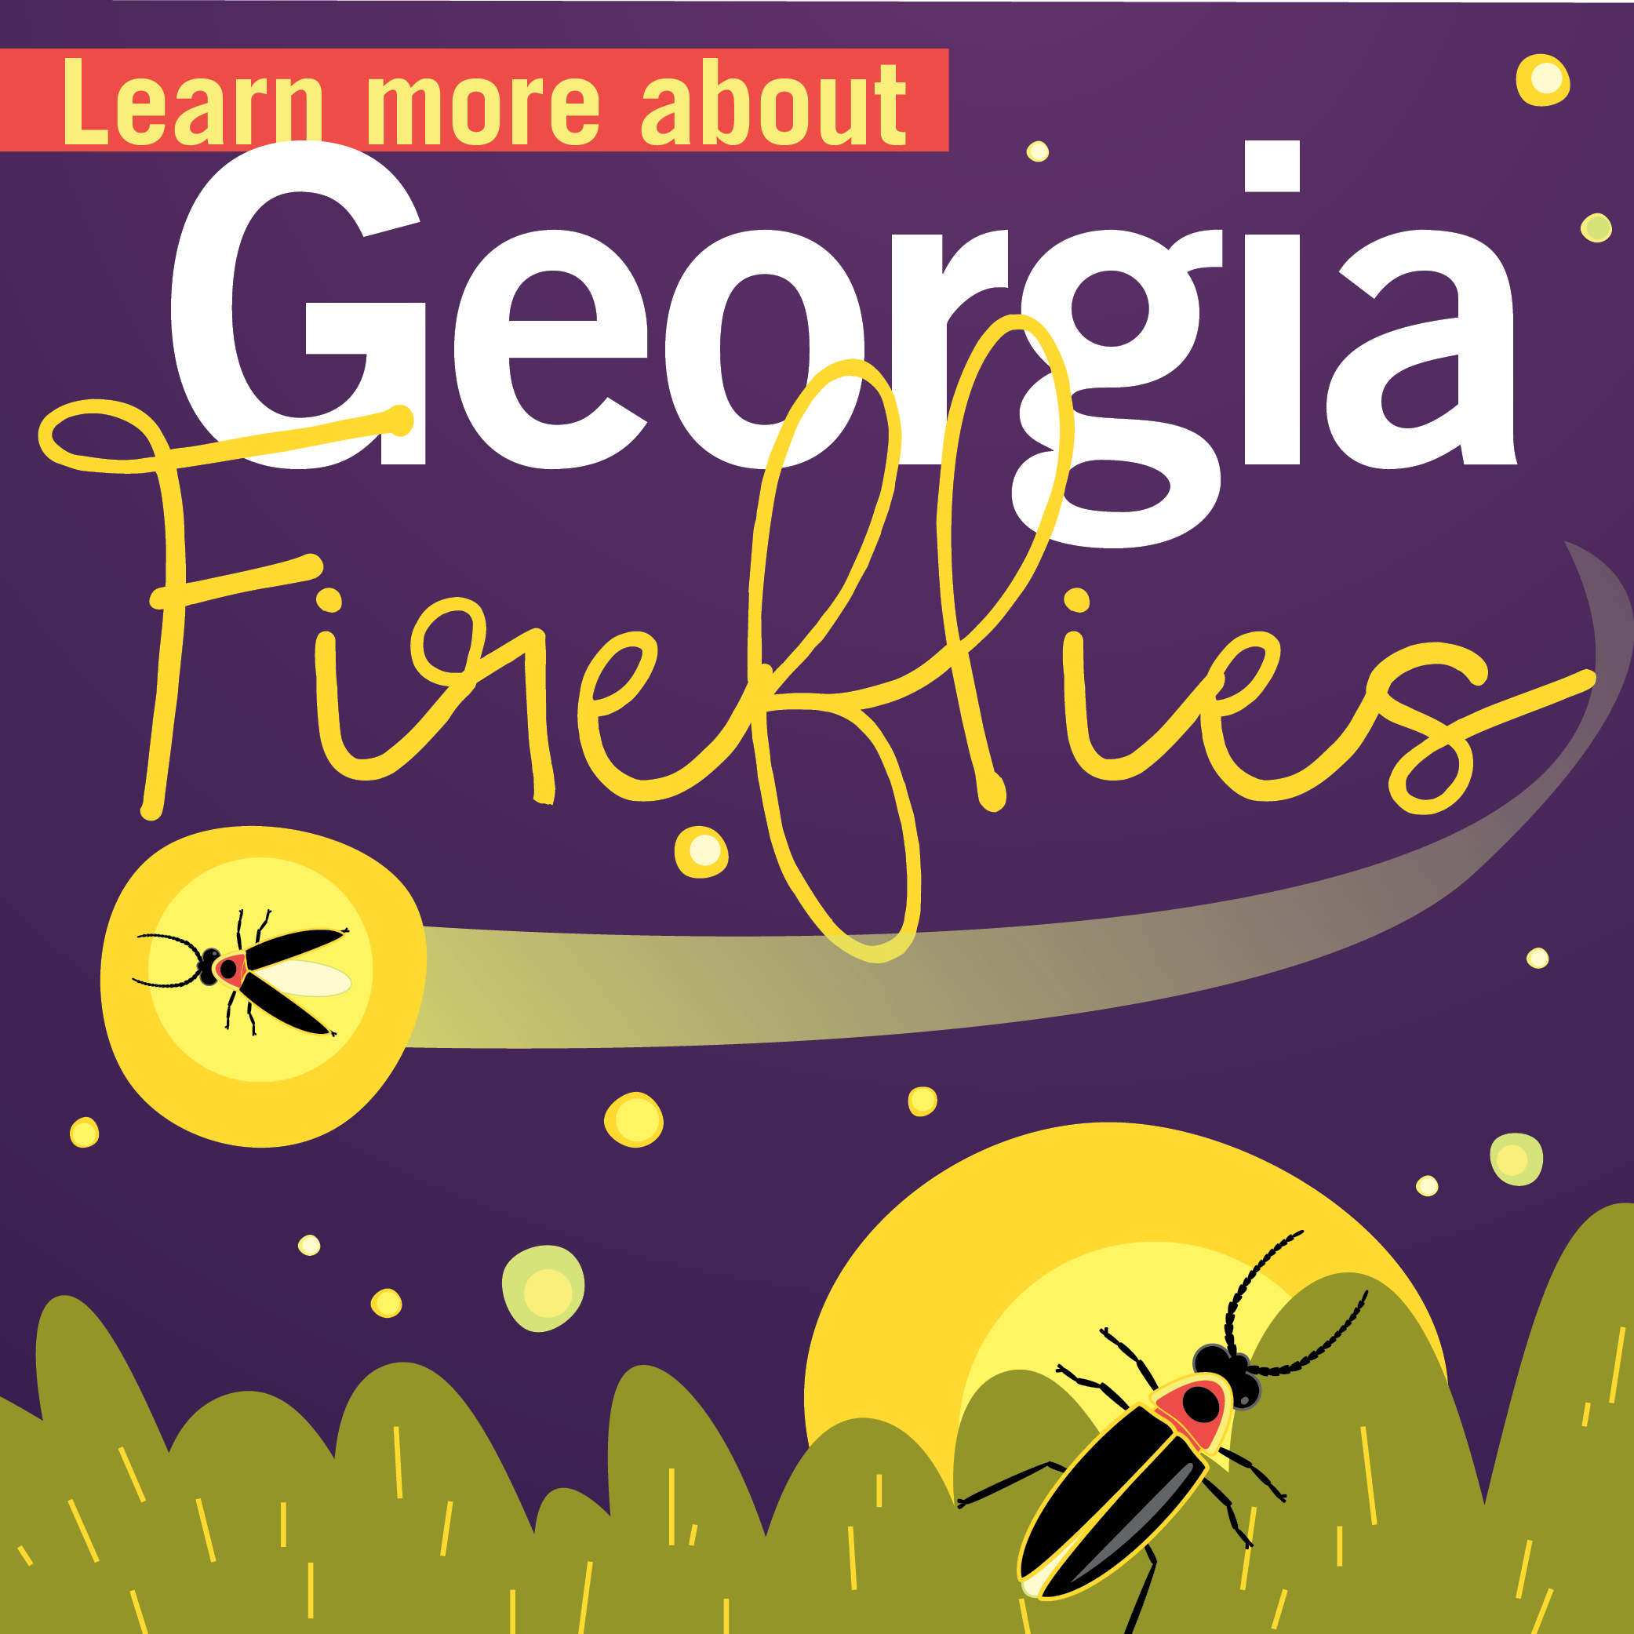
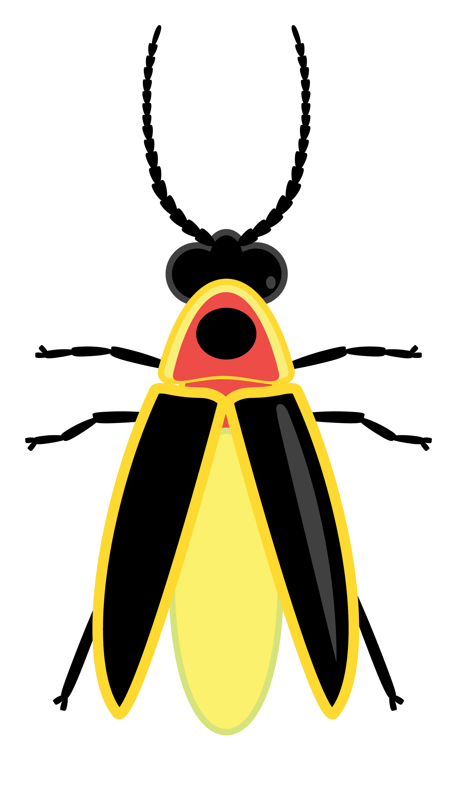
Lights OFF, Fireflies ON
FirefliesON.com
Fireflies Part 2
Creating Firefly Habitat
Becky Griffin
beckygri@uga.edu

Slide 2
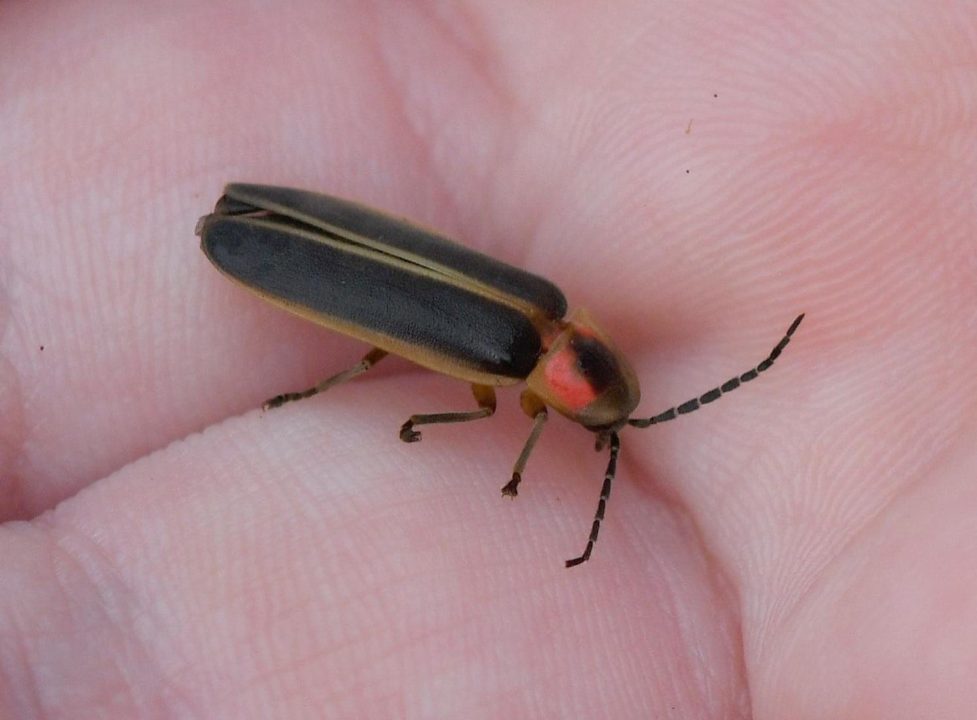
How can we protect fireflies?
Common Eastern Firefly
Photinus pyralis
We can turn off outdoor lights at night.
We can avoid using pesticides.
We can provide for their habitat needs.
Firefly photo by Don Hunter

Slide 3
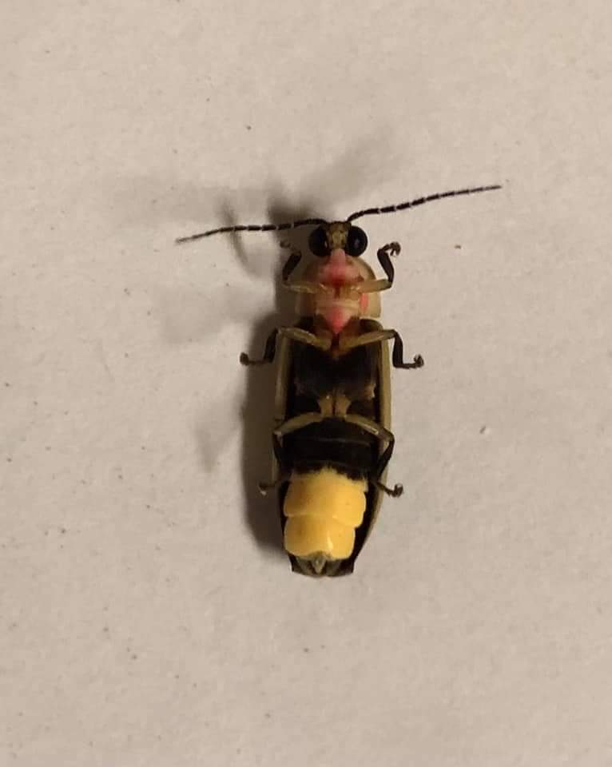
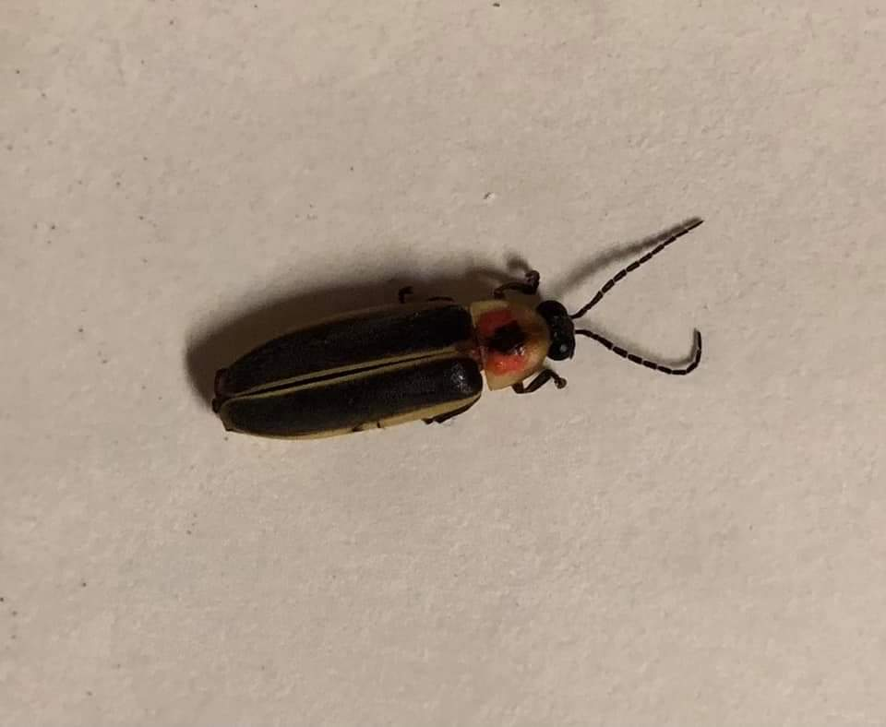
All living creatures need:
Food
Water
Shelter
A place to raise their young
Photo by Jule Lynne Macie
Photo by Jule Lynne Macie

Slide 4
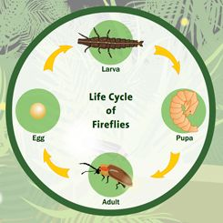
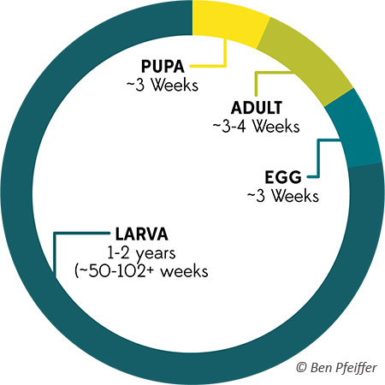
Notes:
In order to conserve fireflies we need to provide habitat for all stages of the fireflies life. The female will lay her eggs on or around rotting logs and twigs. The larval stage of fireflies like to live under leaf liter in wet areas. Remember that fireflies are in the larval stage the longest of any of the stages. Adult fireflies need places to hide from predators which would be trees and shrubs. They also need places to land when they are flying and flashing their lamps. The females need grasses to watch the lights of the males. They also need flowers as some species feed on pollen and/or nectar. It is preferable that the flowers are in a wet area.

Slide 5
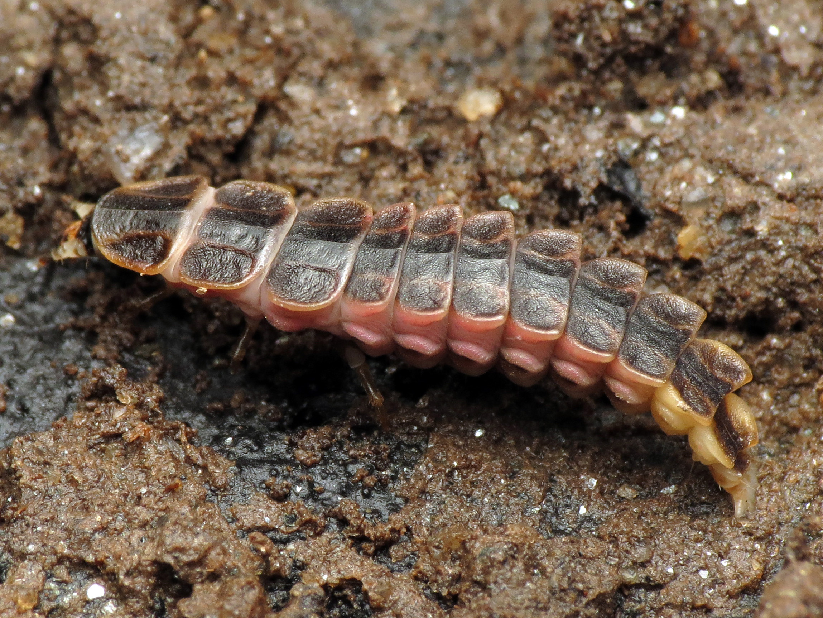
Photo by Katja Schulz, Xerces Society
Notes:
This is the larval form of a firefly. Again, this stage of the firefly needs leaf litter preferably in a wet area.

Slide 6
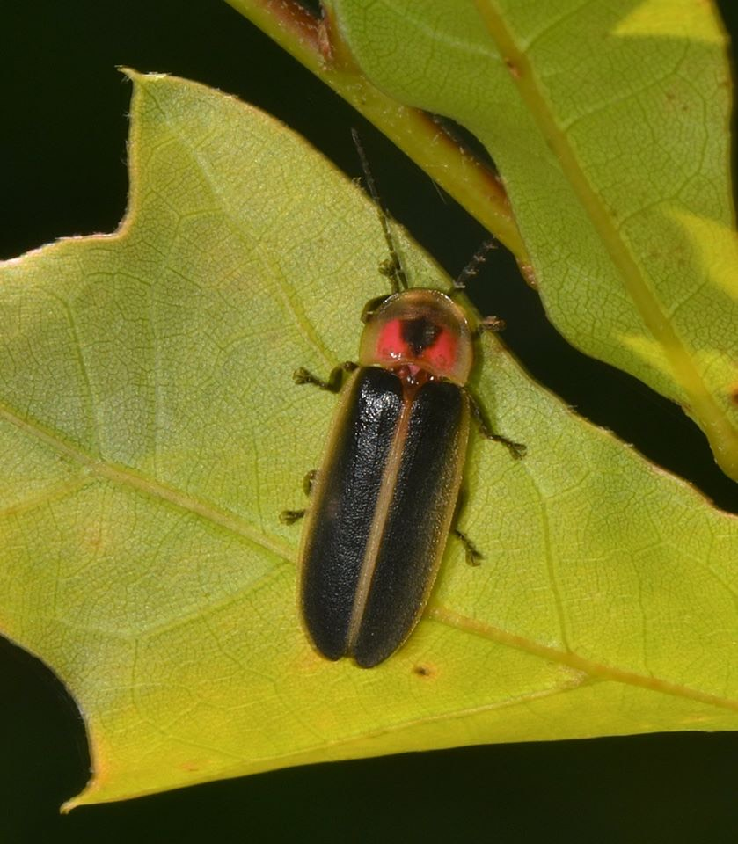
Habitat Requirements
Grasses
Tall shrubs and trees
Shorter shrubs
Flowers
Milkweed
Wet areas
Natural mulch, twigs, logs
Habitat Requirements
Grasses
Tall shrubs and trees
Shorter shrubs
Flowers
Milkweed
Wet areas
Natural mulch, twigs, logs
Photo by Don Hunter

Slide 7
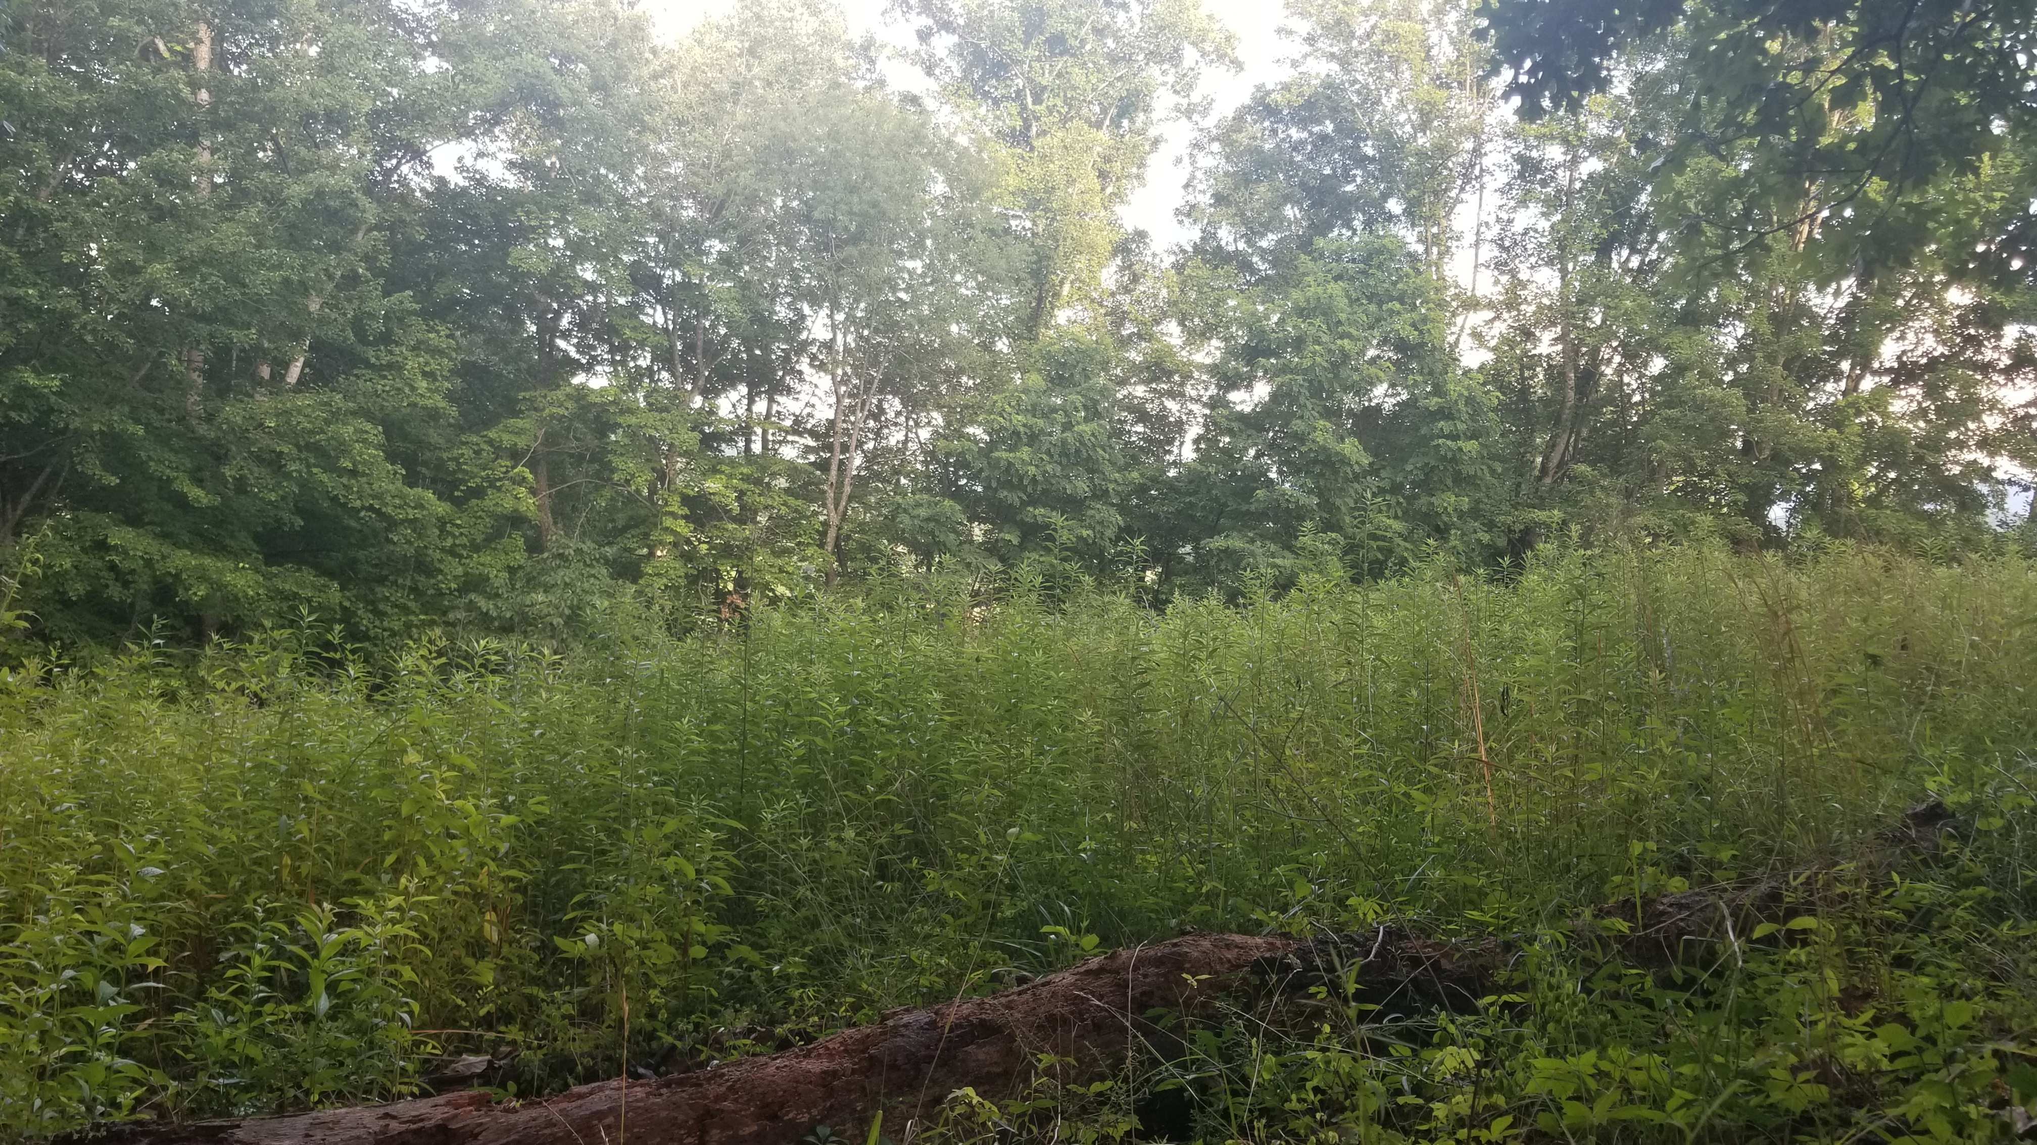
Notes:
This is an example of firefly habitat. Look for rotting logs, grasses, shrubs and trees.

Slide 8
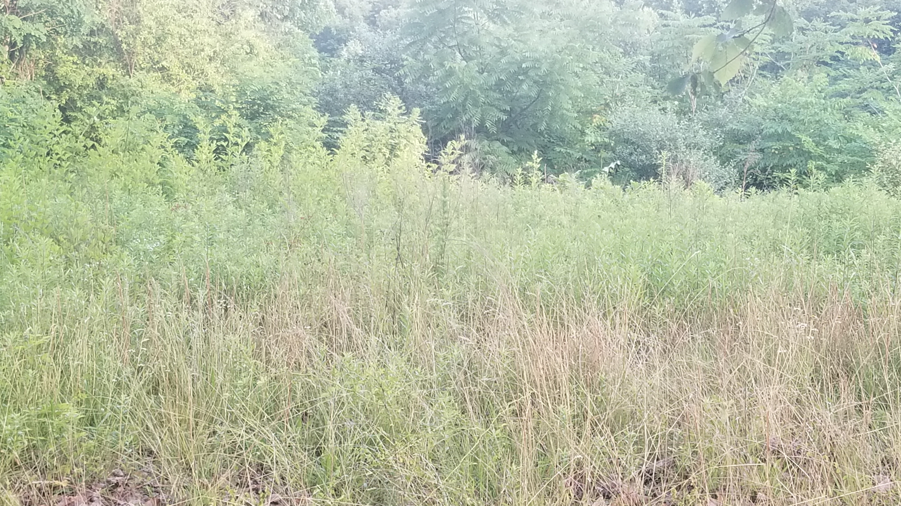
Notes:
This is another example of a firefly habitat. Look for grasses, twigs, shrubs, trees.

Slide 9
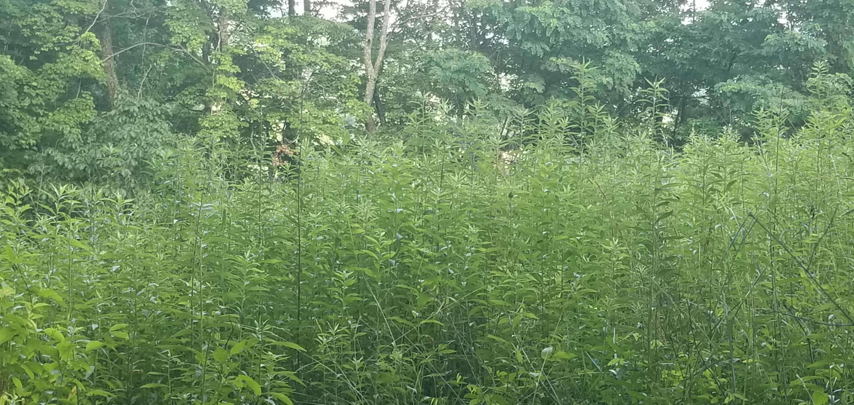
Notes:
One more. Grasses, shrubs, trees….

Slide 10
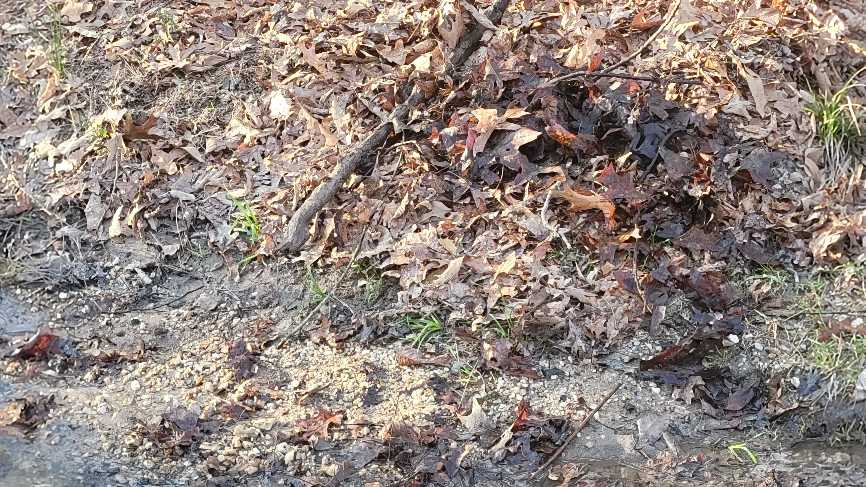
Notes:
Here is a wet area where a firefly female may lay her eggs. Notice the leaf litter (wet) and twigs.

Slide 11
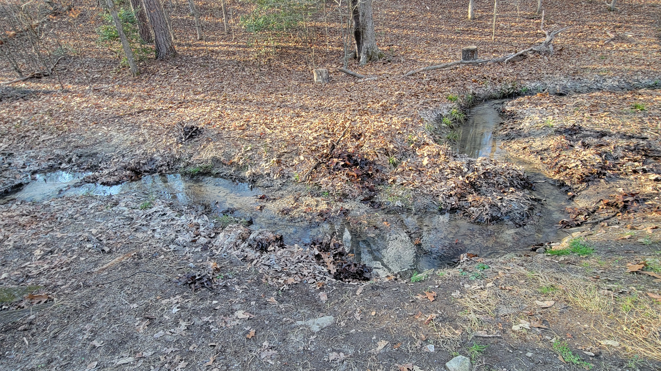
Notes:
This are has plenty of water, leaf litter, twigs, shrubs, and trees.

Slide 12
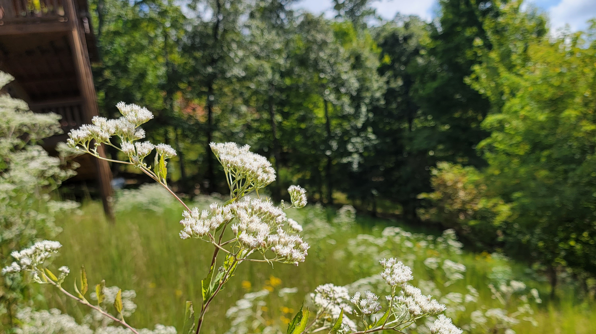
Notes:
This shows flowers among grasses with trees and shrubs in the background

Slide 13
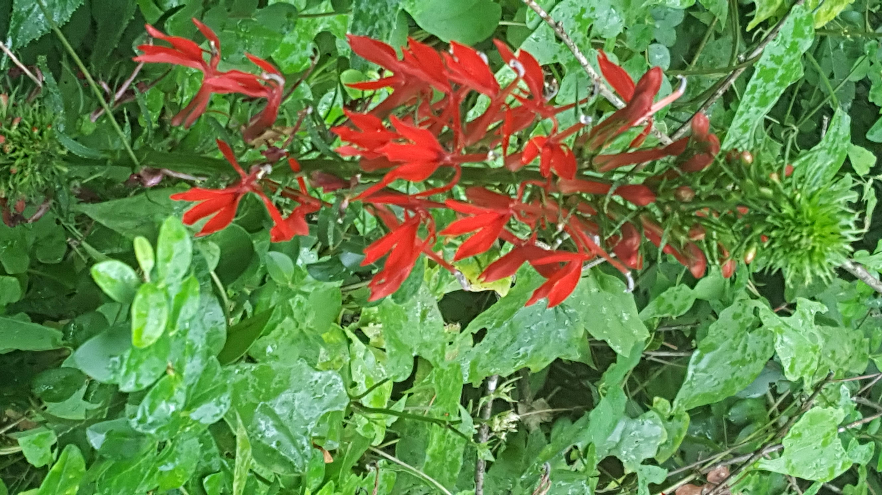
What types of flowers, shrubs and trees would be appropriate to add when creating firefly habitat?
Cardinal Flower
(Lobelia cardinalis)

Slide 14
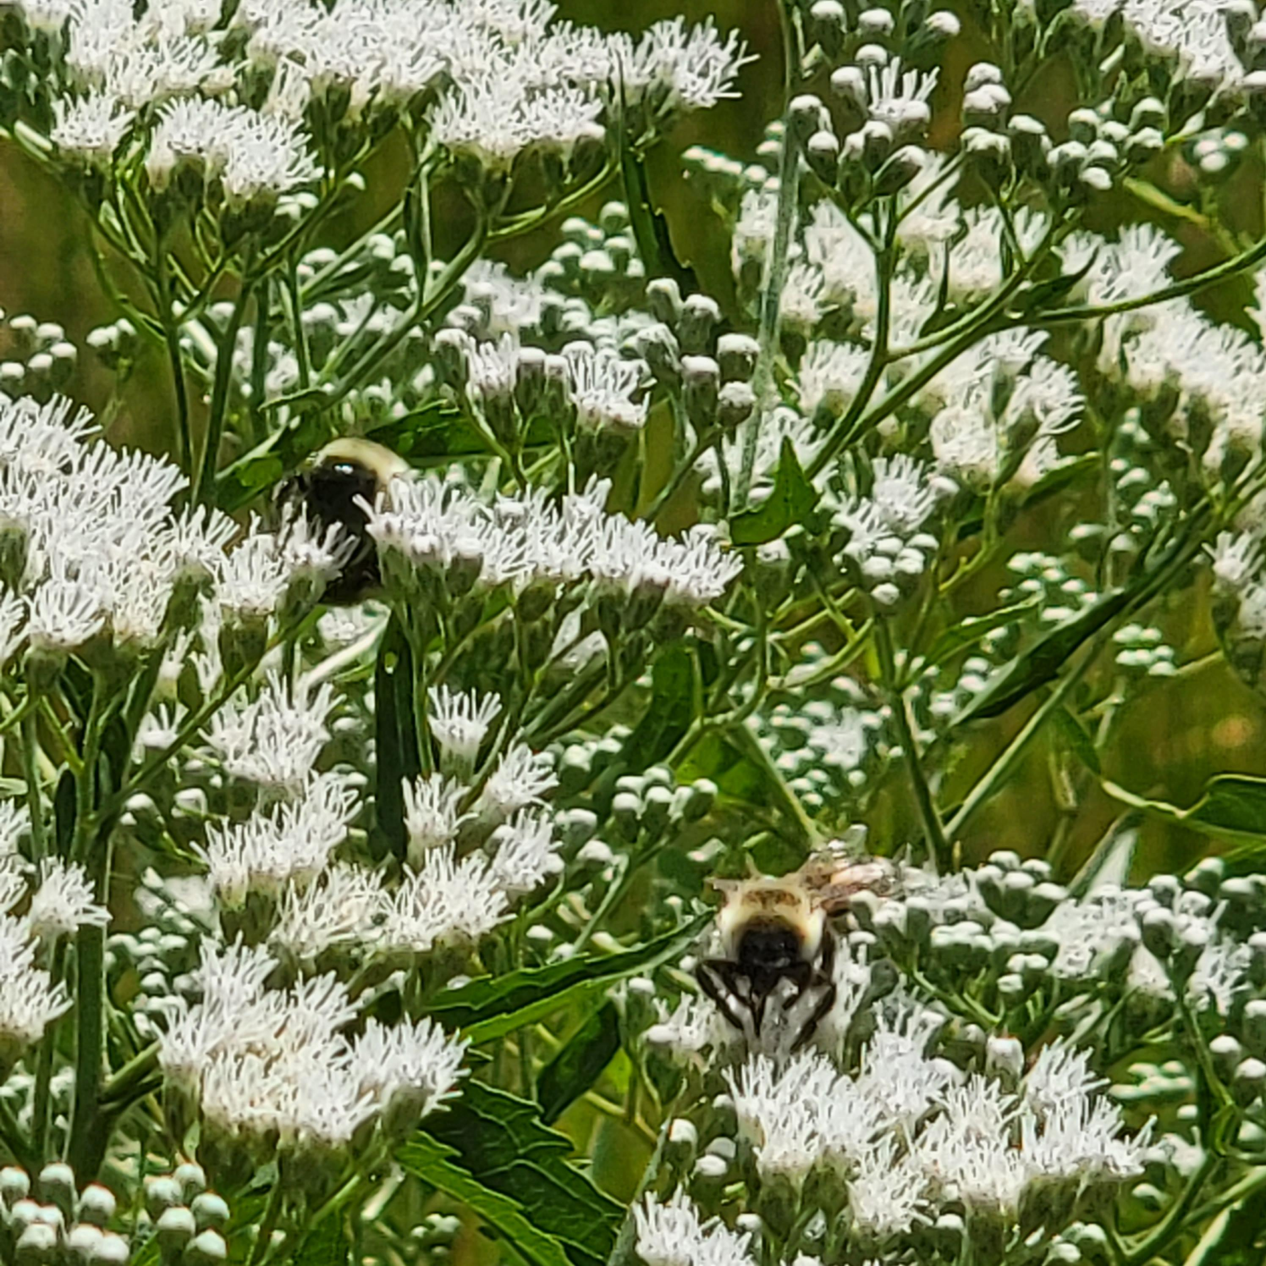
Late Boneset
(Eupatorium serotinum)

Slide 15
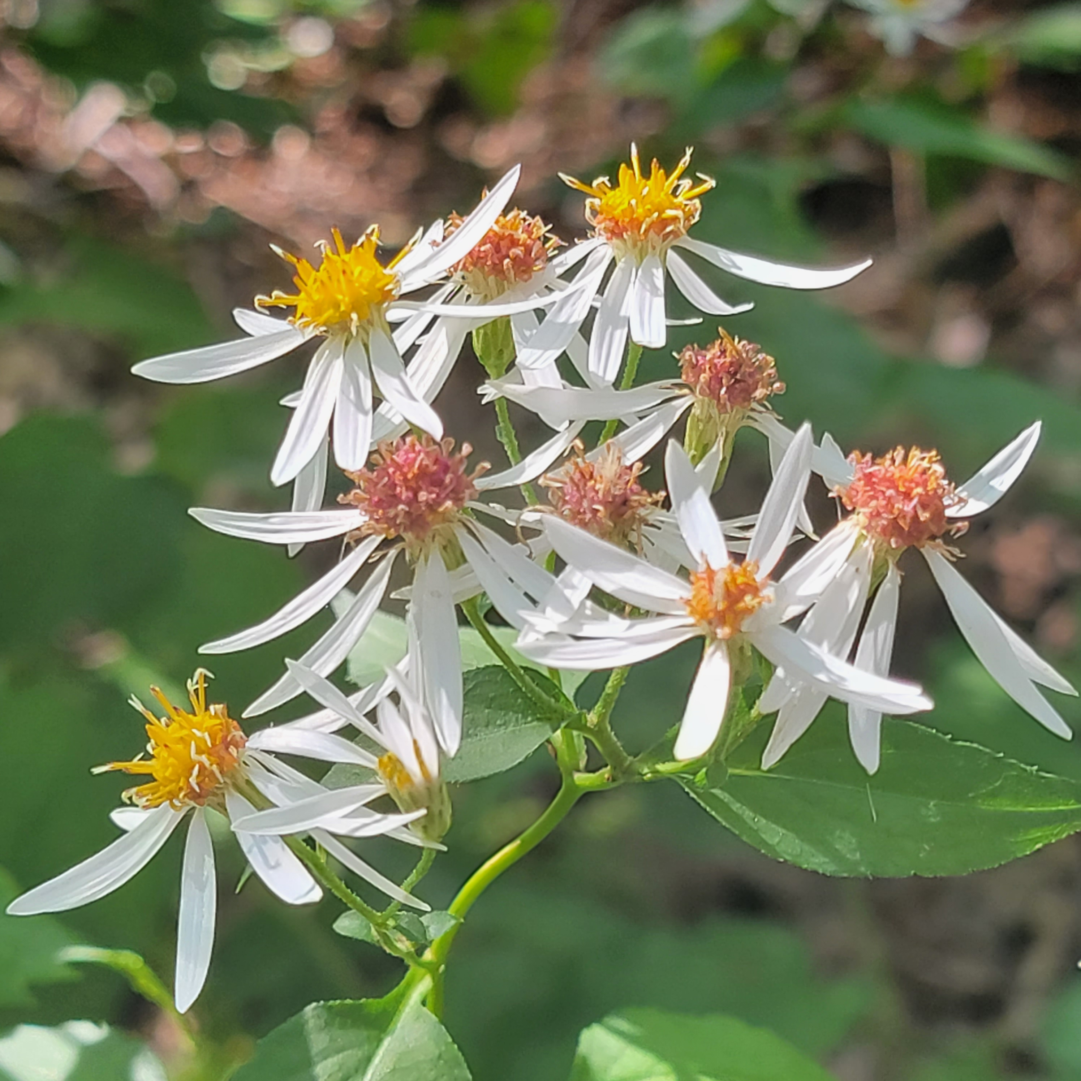
White Wood Aster
(Eurybia divaricata)

Slide 16
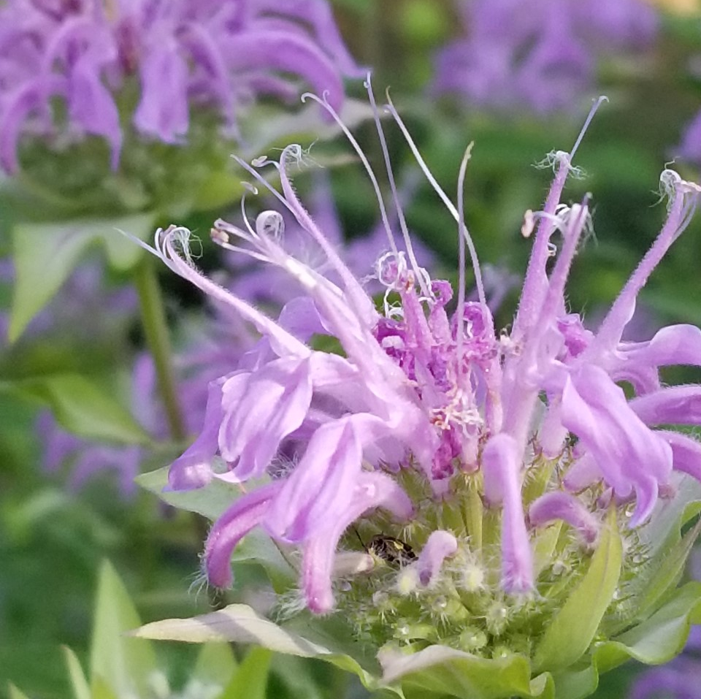
Bee Balm
(Monarda fistulosa)

Slide 17
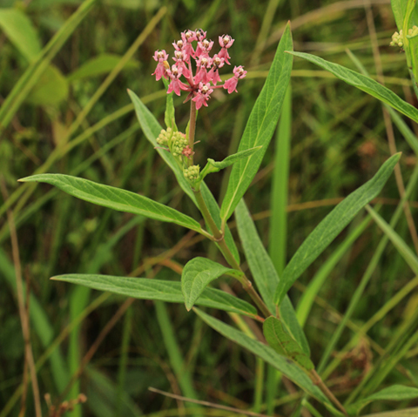
Rose Milkweed
(Asclepias incarnata)

Slide 18
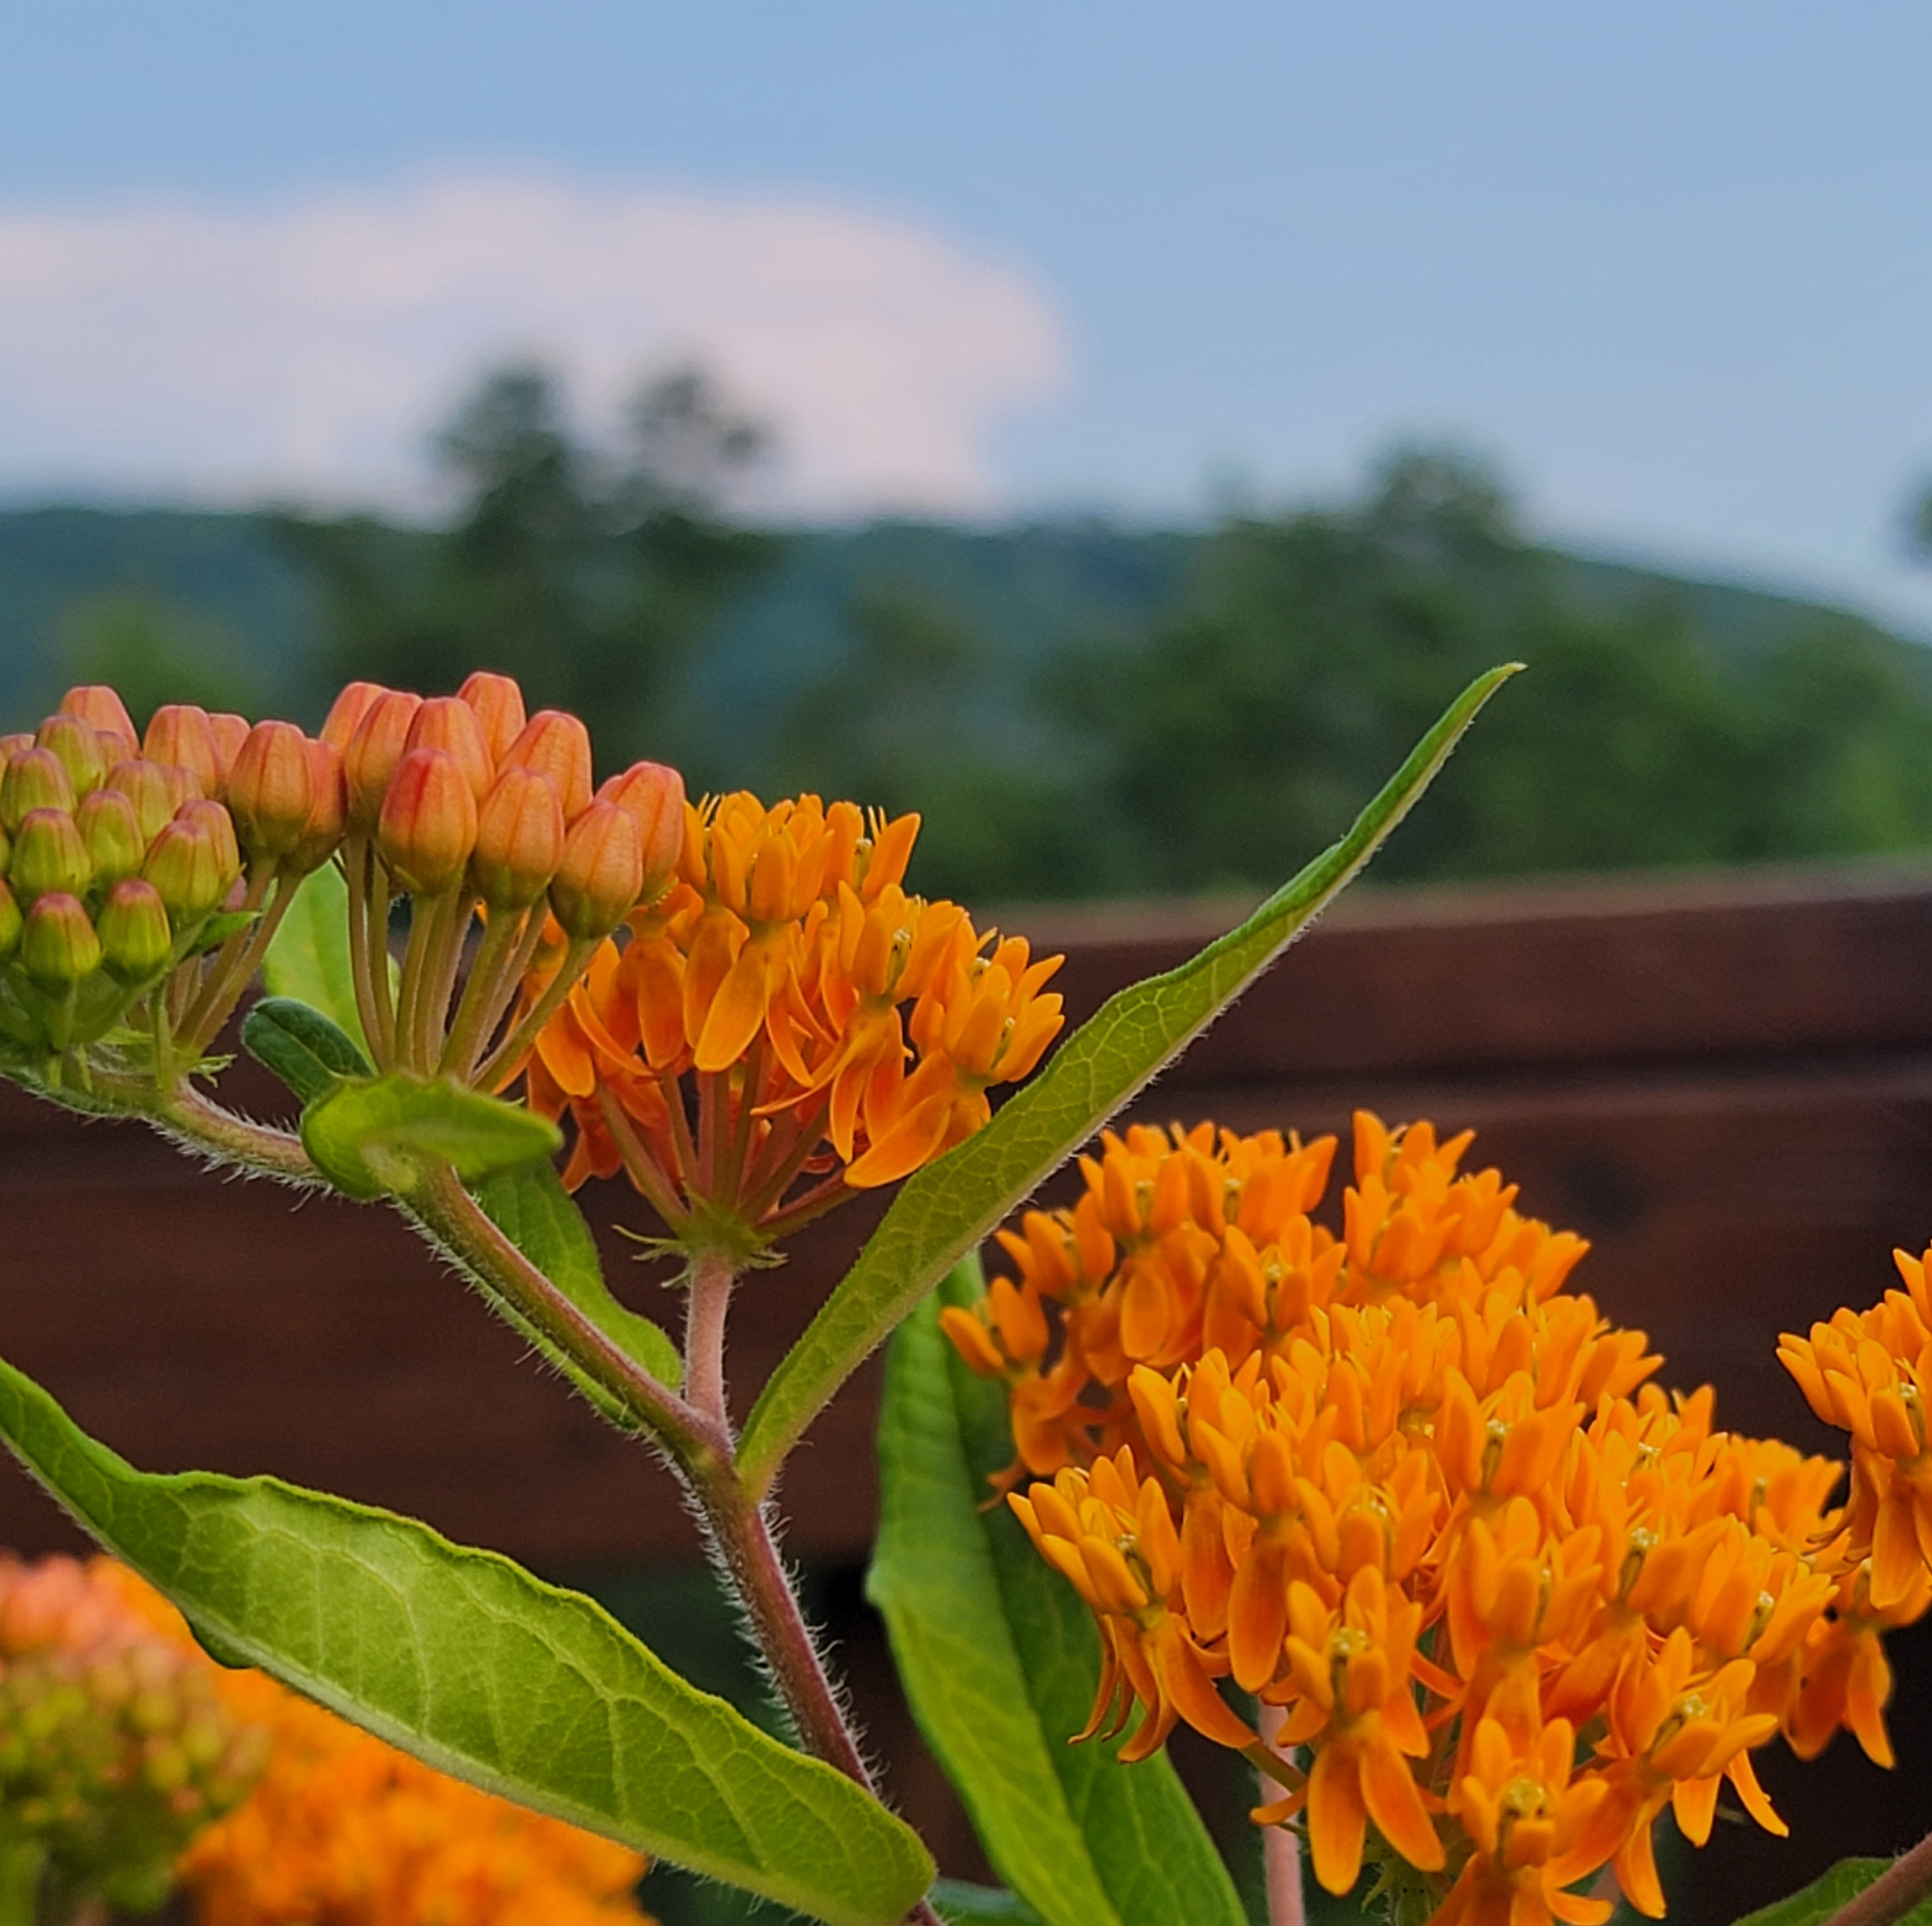
Orange Milkweed – Butterfly Weed
(Asclepias Tuberosa)

Slide 19
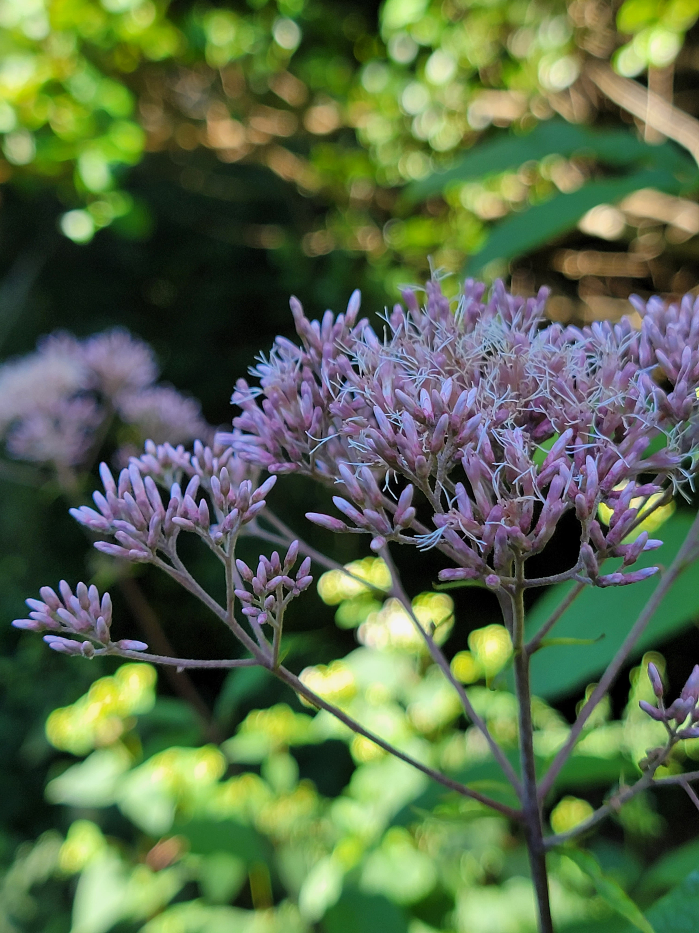
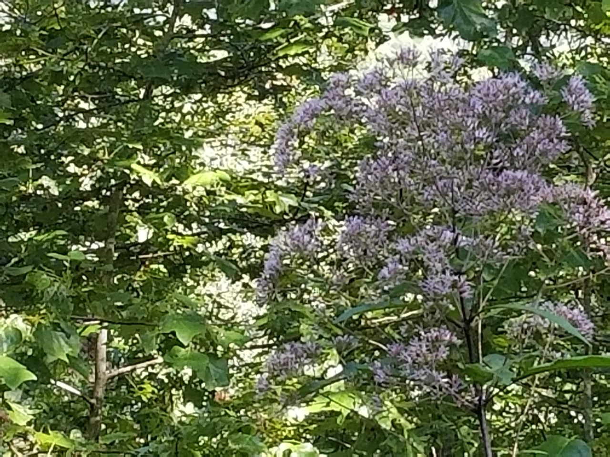
Joe Pye Weed
(Eupatorium fistulosum)

Slide 20
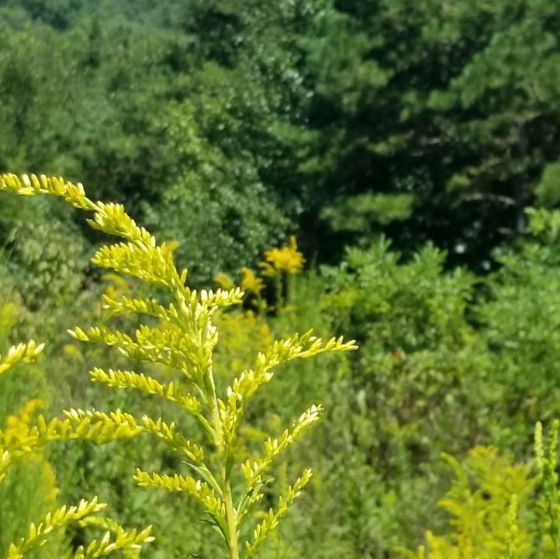
Goldenrod (Solidago spp.)

Slide 21
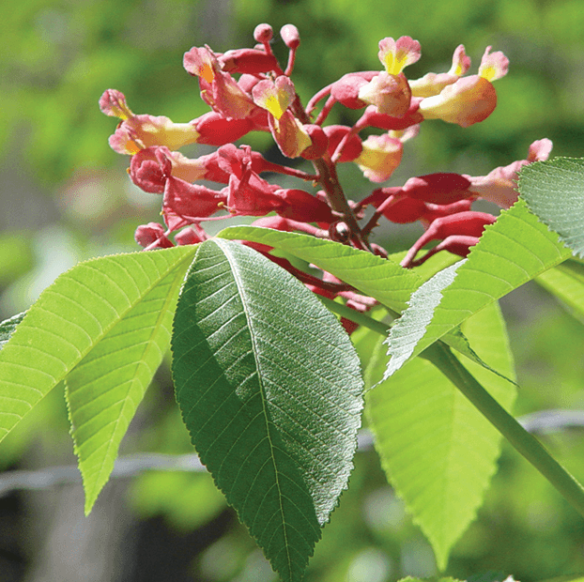
Some examples of shrubs.
Red Buckeye (Aesculus pavia)

Slide 22
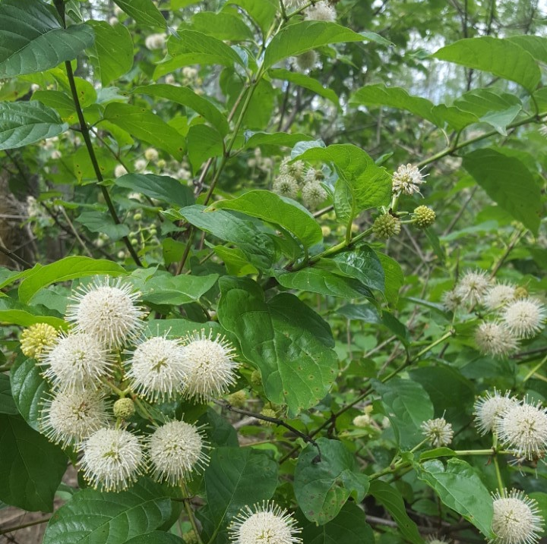
Buttonbush
(Cephalanthus occidentalis)

Slide 23
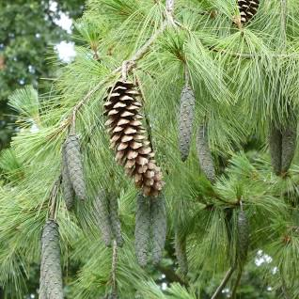
Trees can provide important cover for fireflies escaping from predators. They are also a launching point for fireflies as they fly at night flashing.
Eastern White Pine
(Pinus Strobus)

Slide 24
Firefly Habitat Requirements
Grasses
Tall shrubs and trees
Shorter shrubs
Flowers
Milkweed
Wet areas
Natural mulch, twigs, logs
Photo by Don Hunter

Slide 25
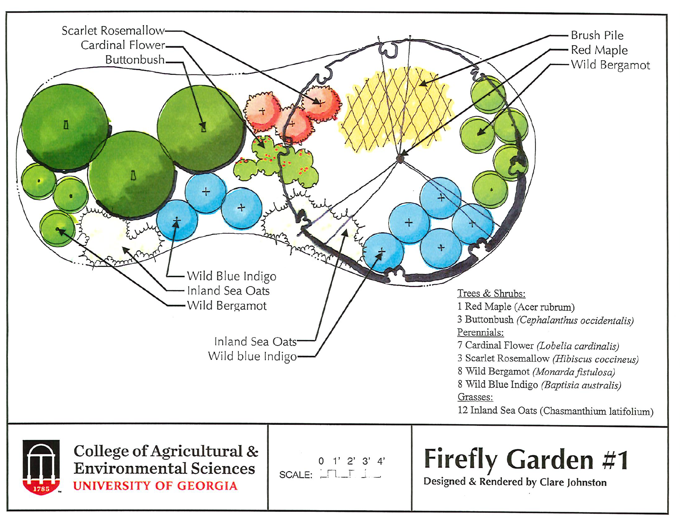

Slide 26
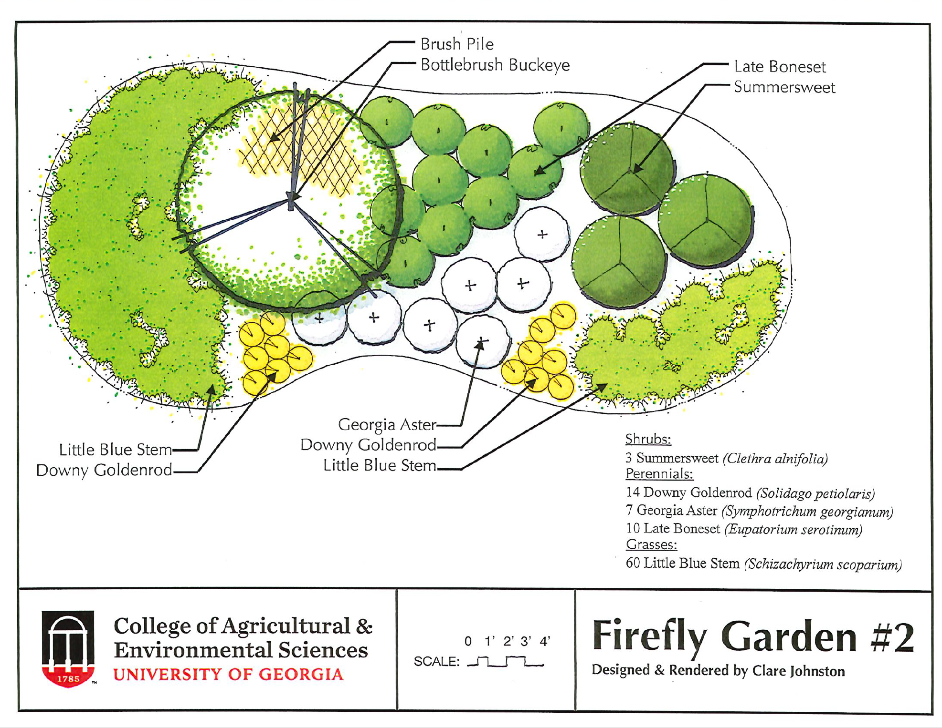

Slide 27
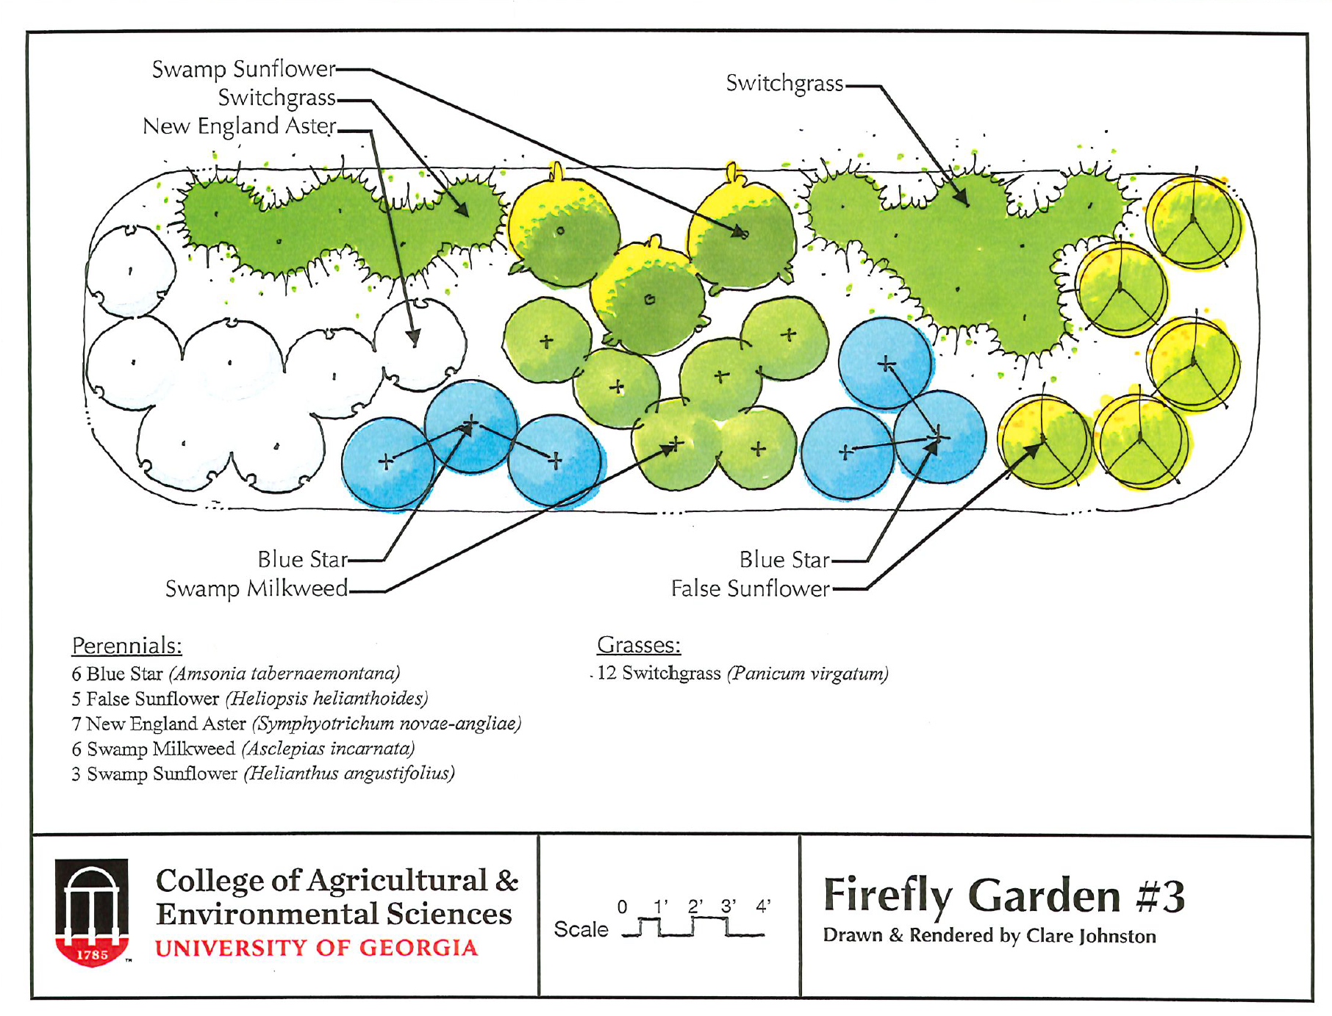

Slide 28
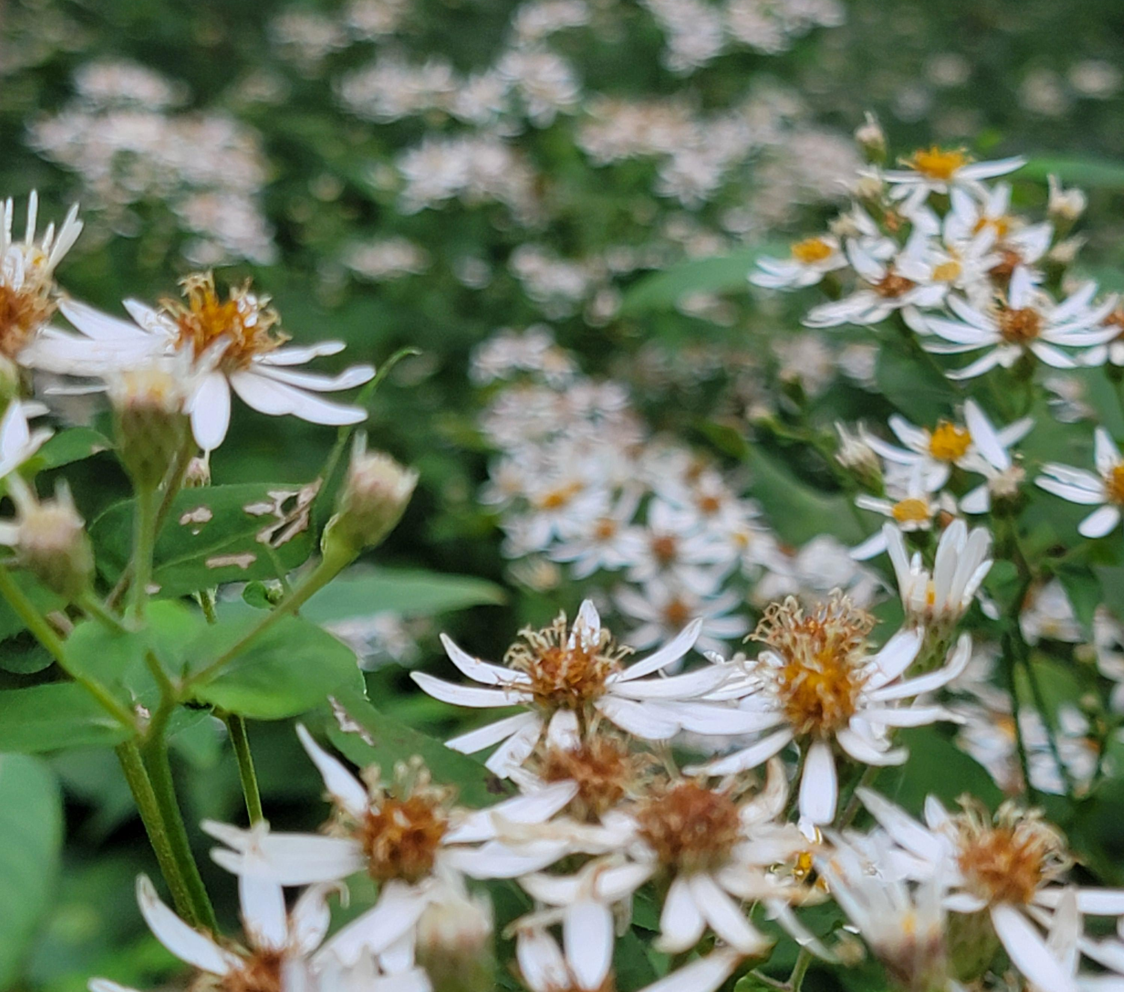
Now, it is your turn to create your own firefly habitat using:
Colored pencils
Paper
Landscape design templates
Seed catalogs with flower inspiration
Notes:
Hand out supplies and let the students design their habitats. Advance this PowerPoint one slide so the students can be reminded of the requirements. Allow a few minutes at the end of the time period for students to share their drawings, highlighting how they met the habitat requirements.

Slide 29
Habitat Requirements
Grasses
Tall shrubs and trees
Shorter shrubs
Flowers
Milkweed
Wet areas
Natural mulch, twigs, logs
Habitat Requirements
Grasses
Tall shrubs and trees
Shorter shrubs
Flowers
Milkweed
Wet areas
Natural mulch, twigs, logs
Photo by Don Hunter

Slide 30
Lights OFF, Fireflies ON
FirefliesON.com
Fireflies Part 2
Creating Firefly Habitat
Becky Griffin
beckygri@uga.edu

